Slide 1
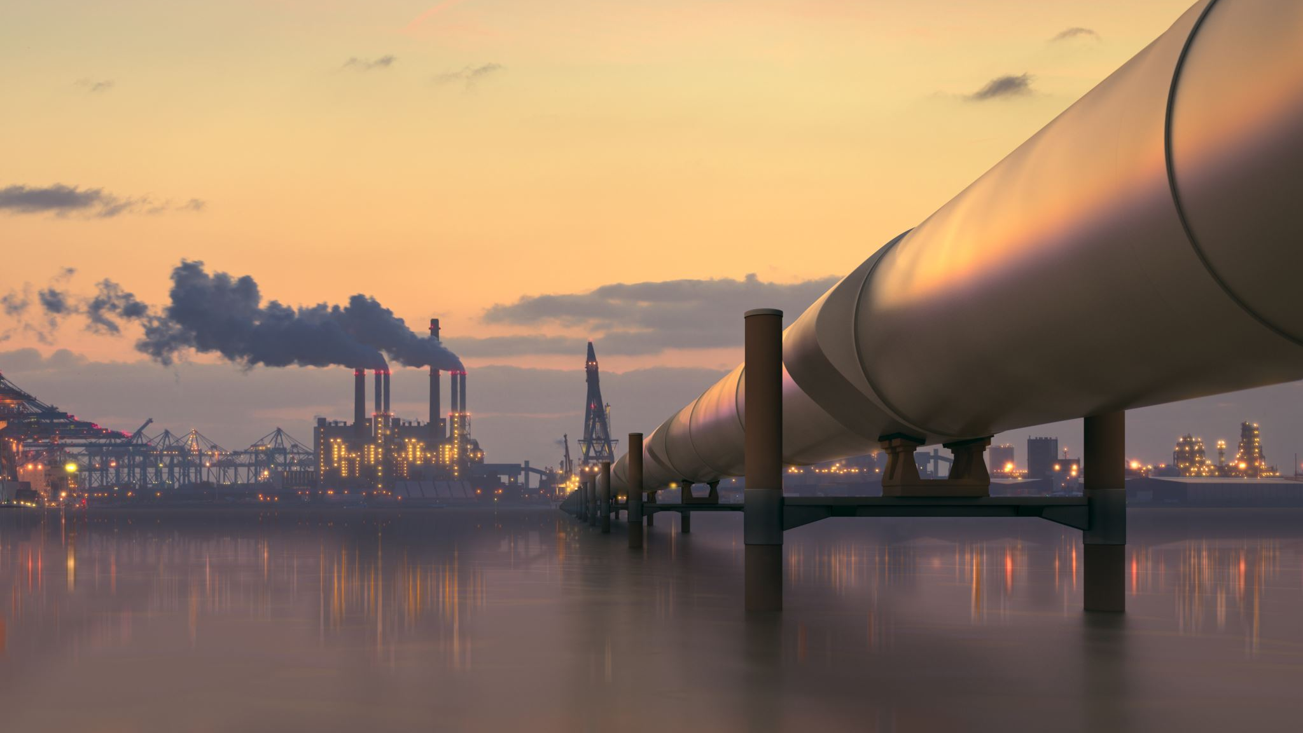
Renewable energy sources: pre-empting a sunset oil industry
Session 5: ME 101 Lecture Series 2024
Aisha Al-Sarihi
Research Fellow, Middle East Institute
National University of Singapore

Slide 2
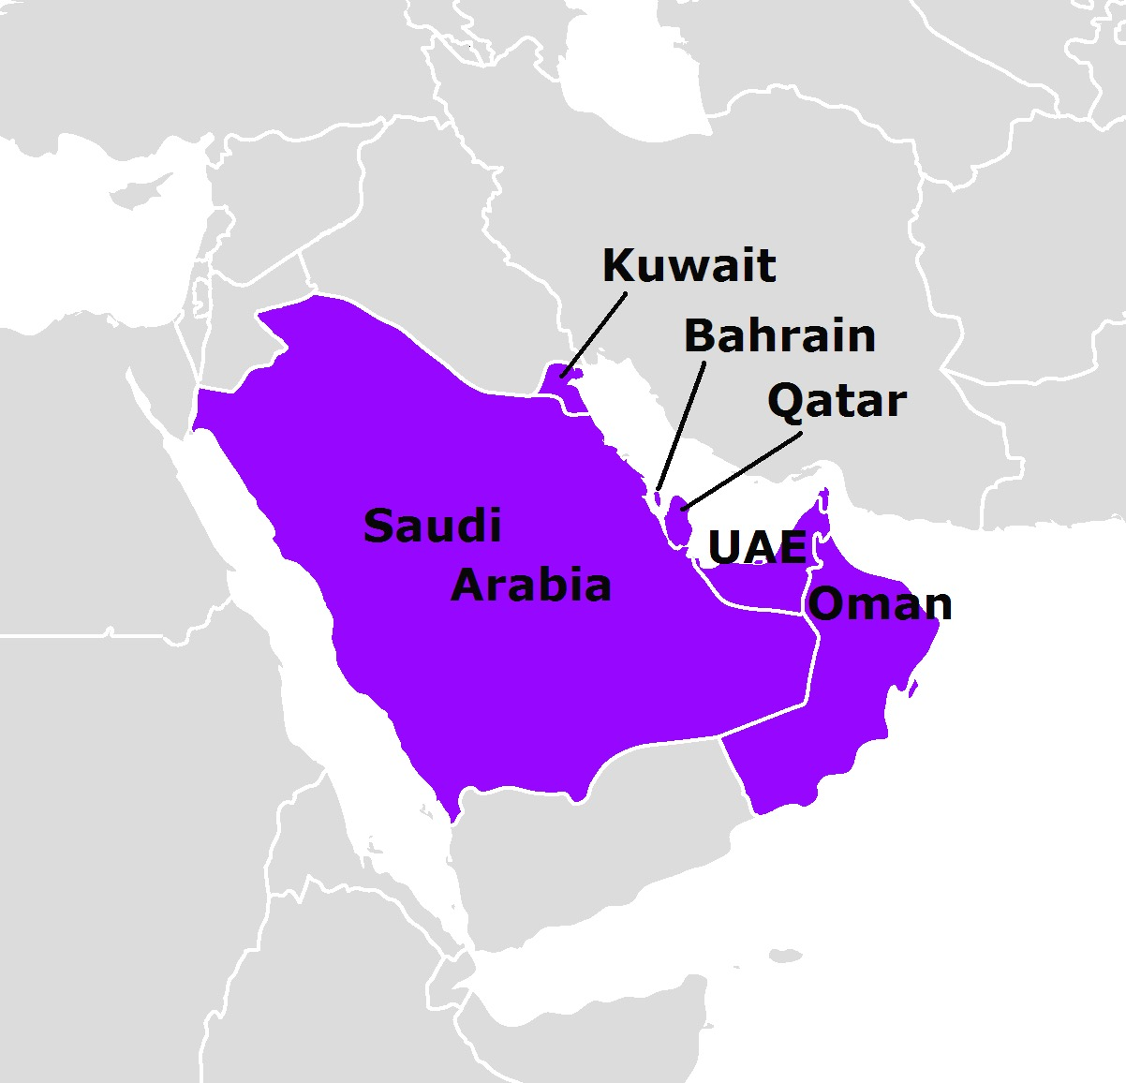
Outline
Oil, gas and Gulf economies
Climate conundrum
Post-oil strategies
Alternative energy
GCC – Singapore energy relations

Slide 3
Outline
Oil, gas and Gulf economies
Climate conundrum
Post-oil strategies
Alternative energy
GCC – Singapore energy relations

Slide 4

Notes:
https://destinationksa.com/the-discovery-of-oil-in-saudi-arabia-here-is-the-story-presented-in-a-way-youve-never-seen-before/
https://www.aramco.com/en/about-us/our-history
Major Frank Holmes: known affectionately by Arabs as "Abu Naft" (the Father of Oil), was a British-New Zealand mining engineer, geologist and oil concession hunter. In 1922 he travelled to Arabia to discuss the possibility of an oil concession with Emir Ibn Saud, who ruled parts of the eastern peninsula. In 1923 he persuaded the sheikh of Bahrain to give him an oil concession in exchange for drilling water wells.

Slide 5




1923
1929
1932
First concession to explore for oil and minerals
Bahrain Petroleum Company (BAPCO) was formed by the Standard Oil Company of California (SOCAL)
Oil was discovered at Well Number One in Jebel Al Dukhan - marking the first such discovery in the Arabian Gulf.
1934
The first ever shipment of Bahrain crude oil was exported to Japan from the Sitra terminal on El Segundo, the Standard Oil Company’s tanker.
1936
Bahrain refinery opened
1948
A large natural gas reserve was discovered by Bapco
1997
BAPCO and BANOCO merged
.
1933
A concession Agreement signed between Saudi Arabia and the Standard Oil Company of California (SPCAL)
1935
Oil drilling began
1938
Commercial oil production Dammam No. 7 “Prosperity Well”
1988
.
1943
The name of the company in control in Saudi Arabia was changed to Arabian American Oil Company (ARAMCO)
Saudi Government bout 100% stakes of Arabian American Oil Company (ARAMCO) and was renamed to Saudi Arabian Oil Company (Saudi Aramco)
.
.
1937
1967
.
1962
Oil was found in Yibal, Natih and Fahud
First Omani oil was exported to Japan
.
Iraq Petroleum Company was granted a 75-year concession to explore oil in Oman; Petroleum Development (Oman and Dhofar) Ltd was established.
1972
Omani government acquired a 60% stake in PDO
1951
Petroleum Development Oman (PDO) was adopted.
.
1935
First geological survey
1939
First concession signing
1958
First oil discovery in Murban Bab oil field
1971
.
1963
First crude tanker was exported
Abu Dhabi National Oil Company (ADNOC) founded

Slide 6
Gulf countries hold a large portion of global oil and gas reserves, with a potential production lasting for decades.
Proven oil reserves, 2021
Crude oil production, 2023
Proven natural gas reserves, 2021
Crude oil export, 2023
Source: BP Statistical Review of World Energy 2021
© 2024 Organization of the Petroleum Exporting Countries

Slide 7
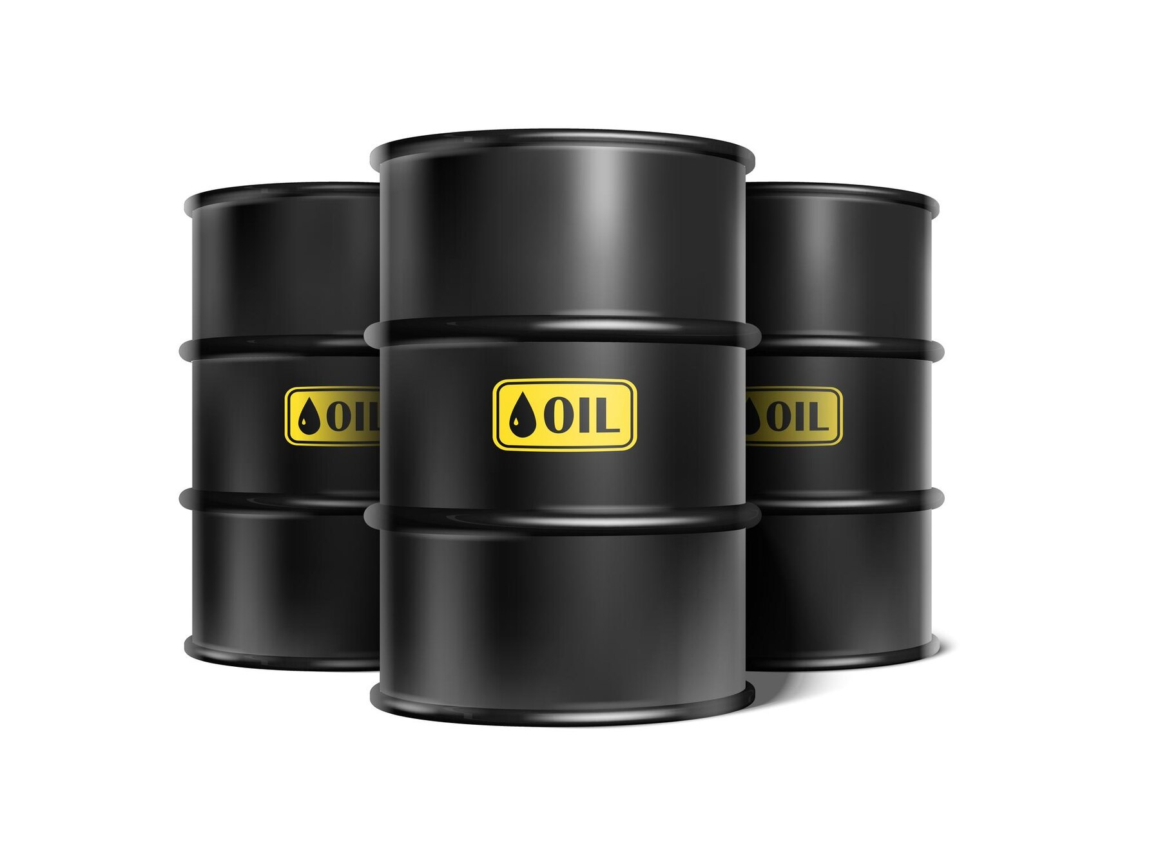
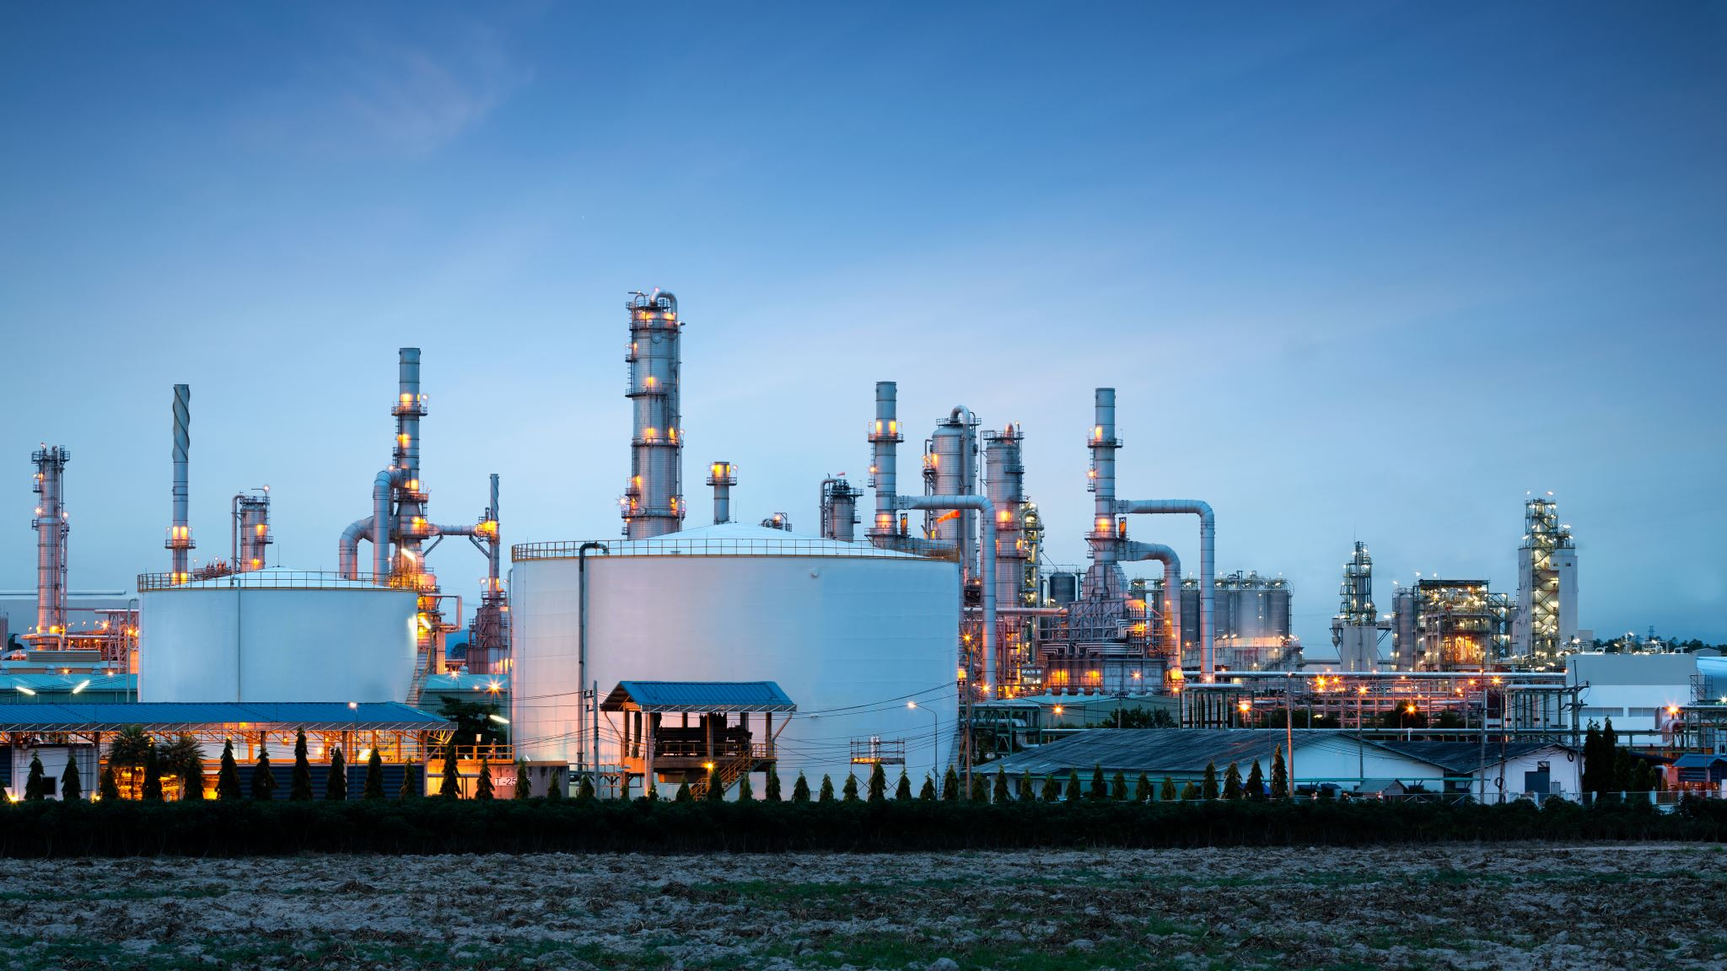
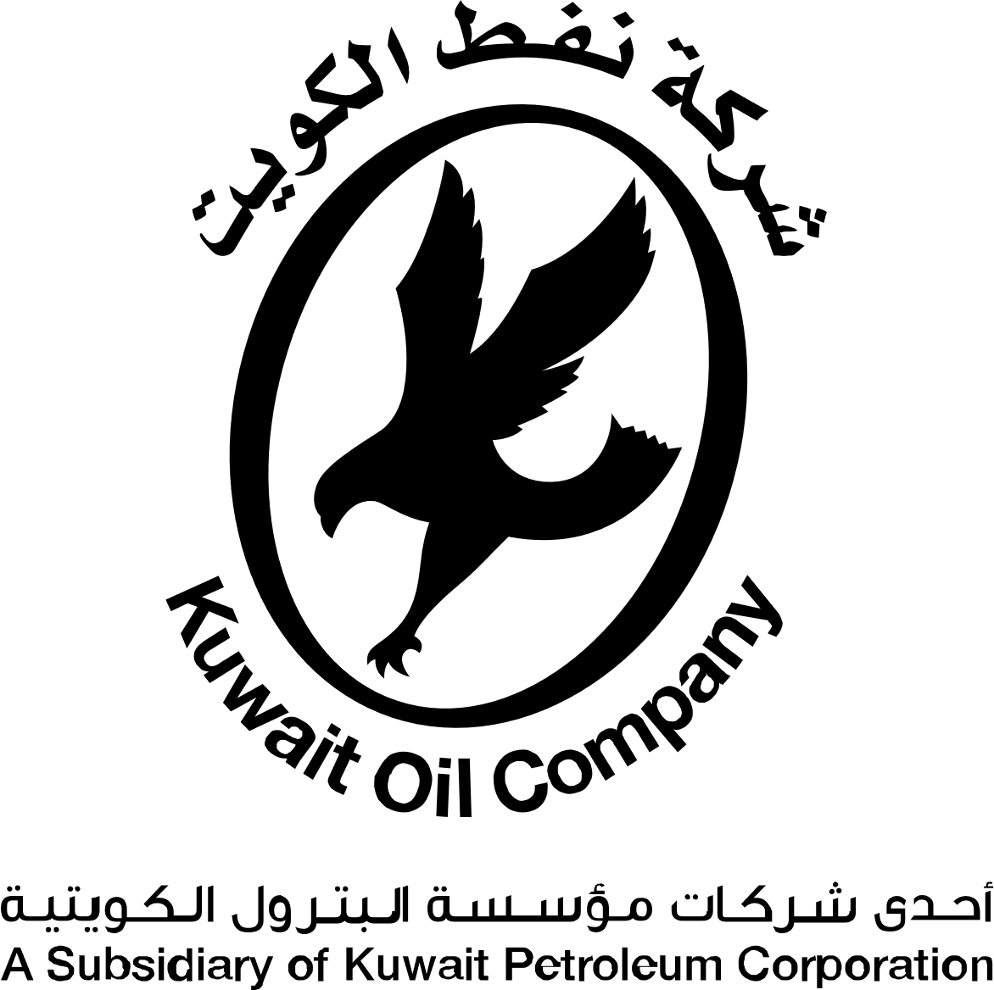
88%
70-80%
Export
Production
52%
Refining
Petrochemicals
Export
37%
35%
Industry
12%
6%
Power Generation
20-30%
Domestic use
Transport
Enhanced oil recovery
Aviation and Shipping
Notes:
https://www.eia.gov/energyexplained/oil-and-petroleum-products/imports-and-exports.php

Slide 8
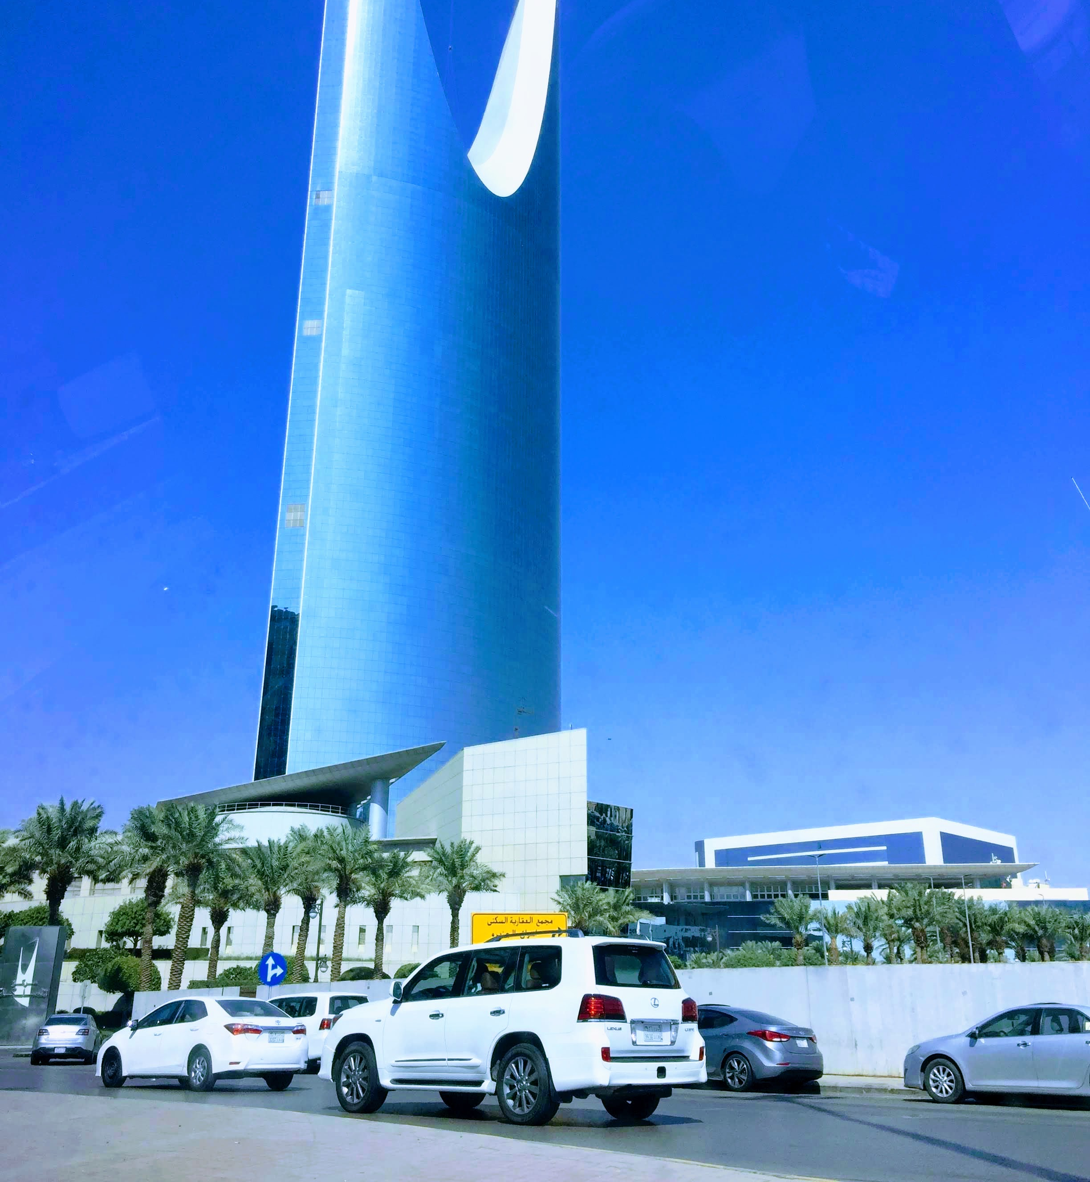
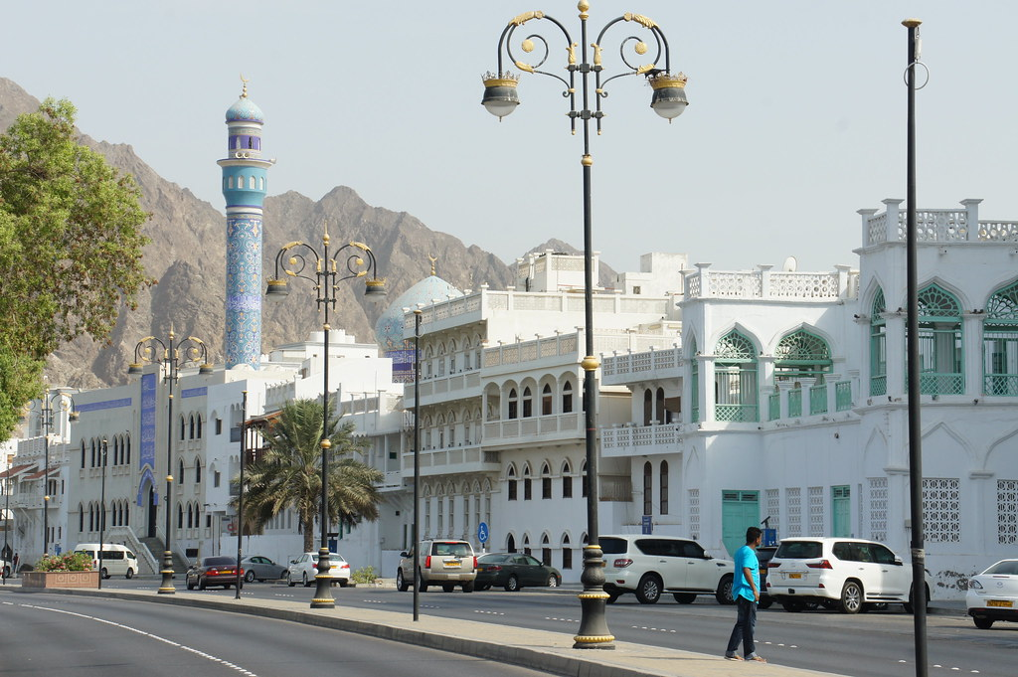
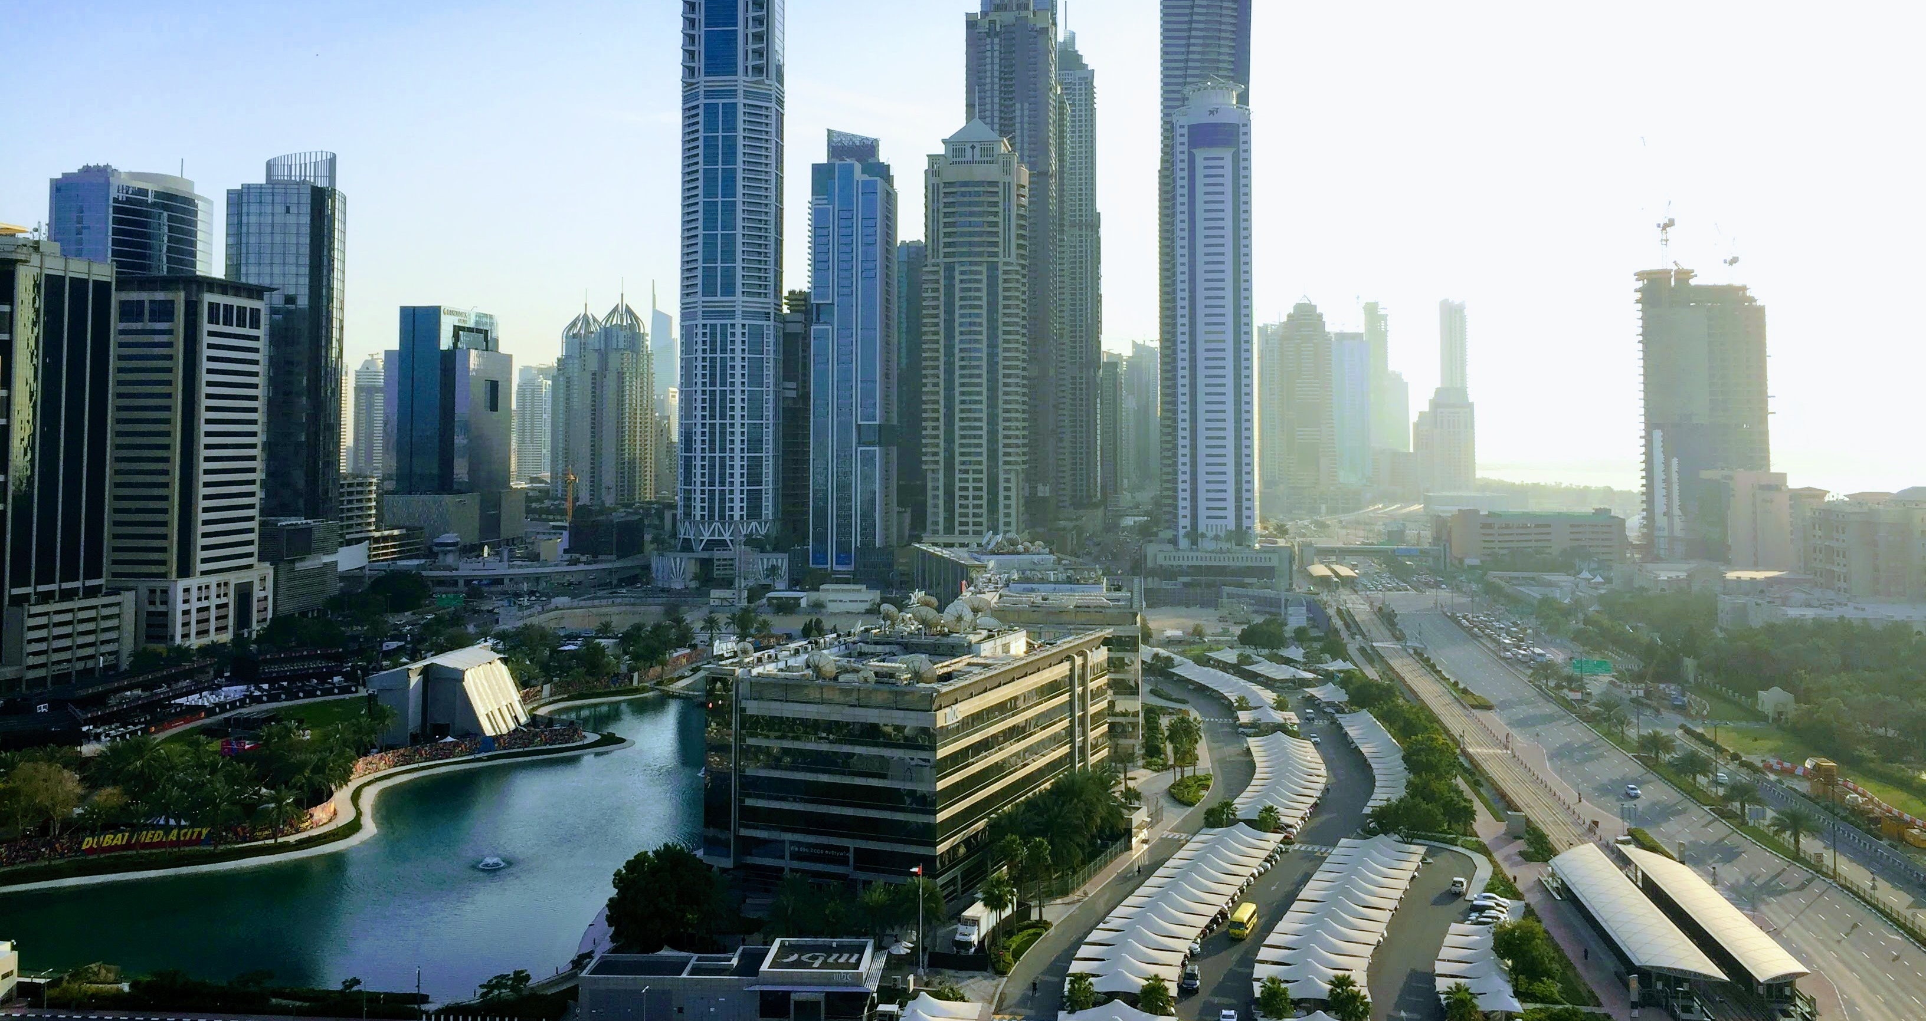
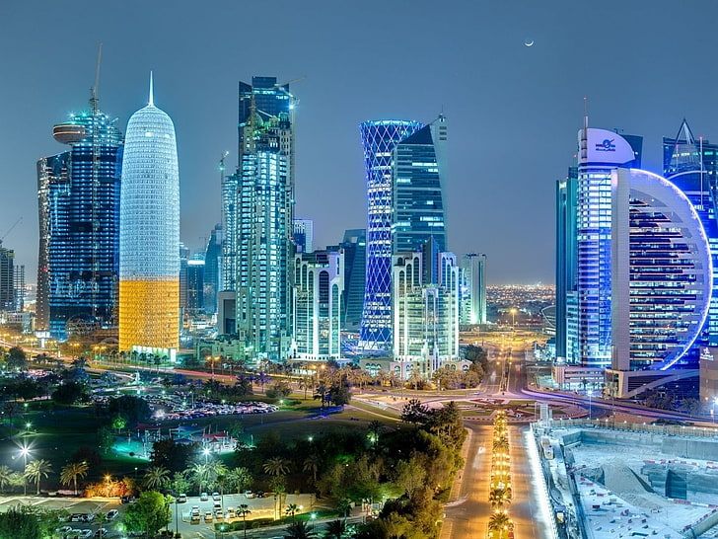
Gulf countries, oil, gas, and economies
Riyadh, Saudi Arabia
Doha, Qatar
Muscat, Oman
Dubai, UAE

Slide 9
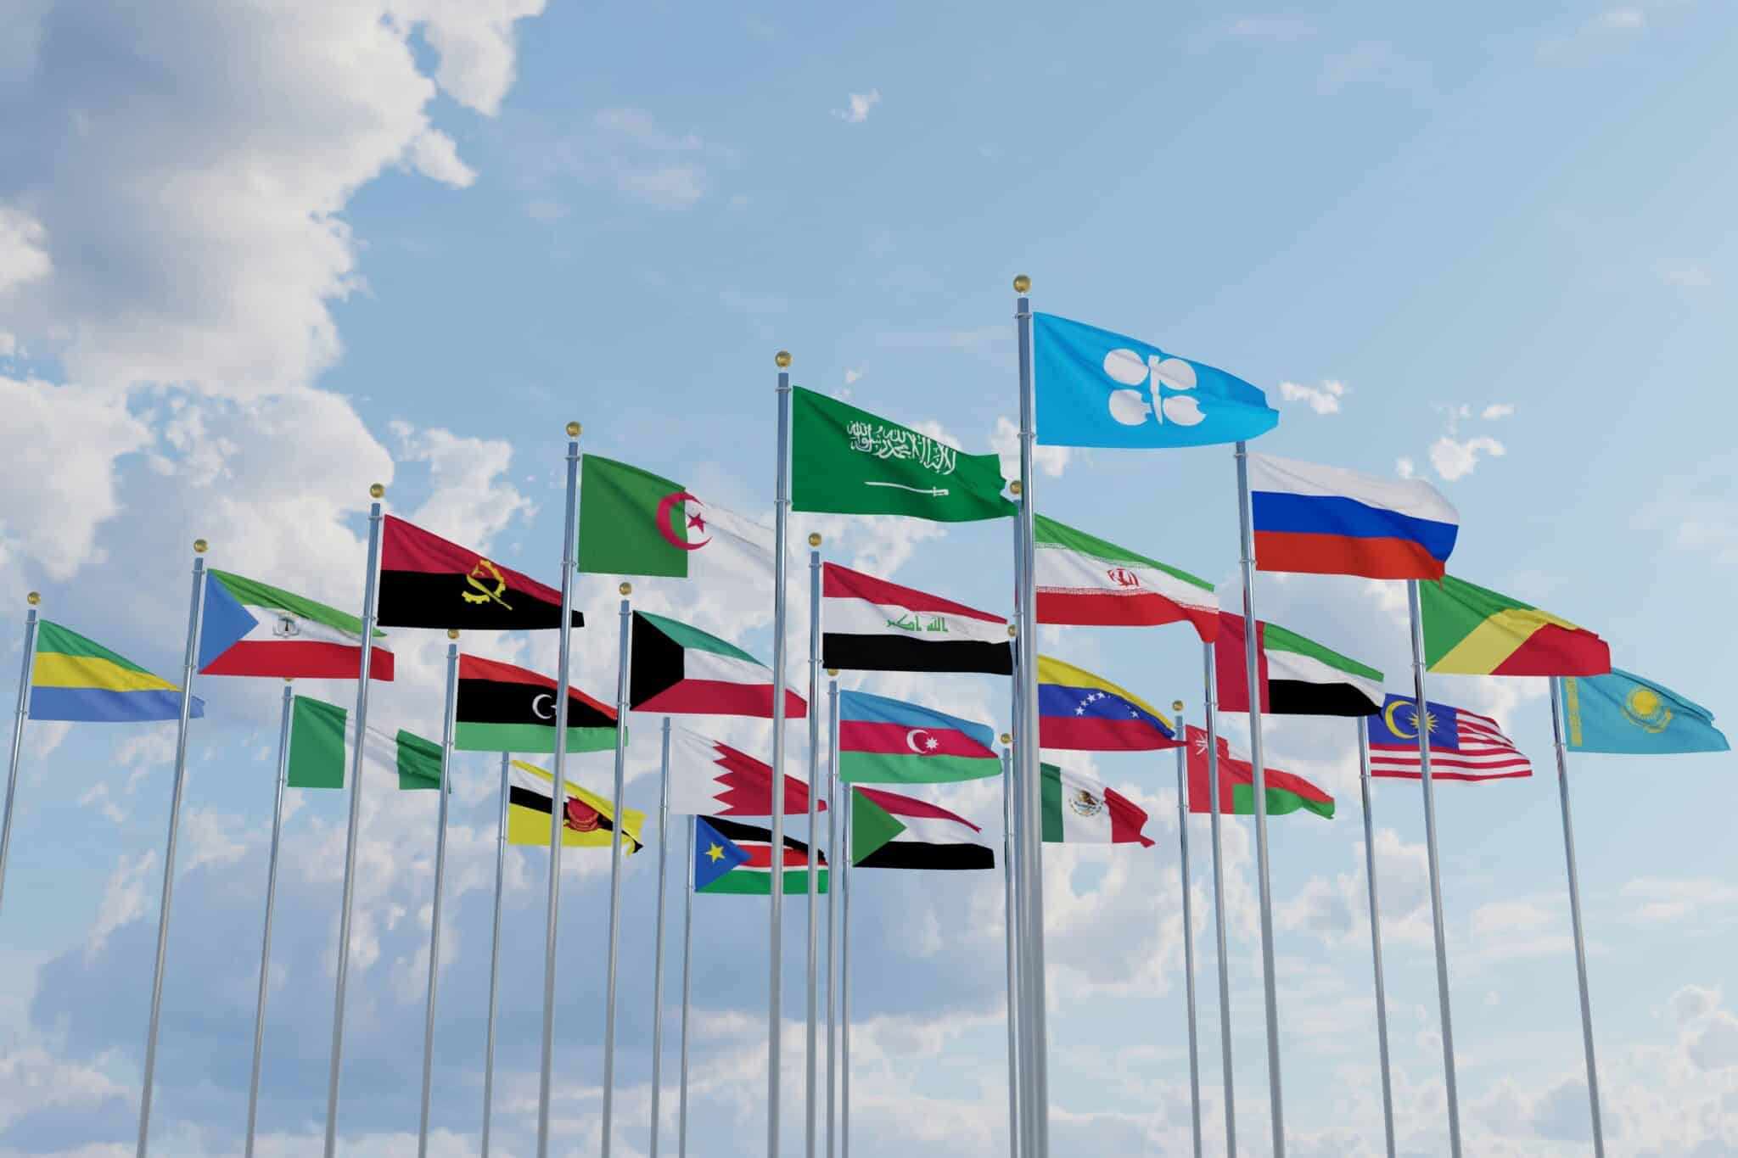
The Organization of the Petroleum Exporting Countries (OPEC)
Created at the Baghdad conference in 1960, by Iran, Iraq, Kuwait, Saudi Arabia and Venzuela, to counter the dominance of the“Seven Sisters” – CHEVRON, EXXON, MOBIL, TEXACO, GULF OIL, ANGLO IRANIAAN OIL COMPANY, ROAYAL DUTCH SHELL
Headquarter in Geneva for the first five years, then moved to Vienna since 1965 until today.
Currently 12 Member countries: Algeria, Congo, Equatorial Guinea, Gabon, Iran, Iraq, Kuwait, Libya, Nigeria, Saudi Arabia, United Arab Emirates, Venezuela.
OPEC members control about 72% of total world proved crude oil reserves (plus lease condensate), and around 37% of total world crude oil production as of 2021.
2016: OPEC and non-OPEC Declaration of Cooperation
OPEC's total spare capacity is 5.1 million bpd, of which 3.2 million bpd is held by Saudi Arabia, 1 million bpd by the UAE, 400,000 bpd by Iraq and 300,000 bpd by Kuwait (The International Energy Agency).
Notes:
https://www.eia.gov/energyexplained/oil-and-petroleum-products/prices-and-outlook.php

Slide 10
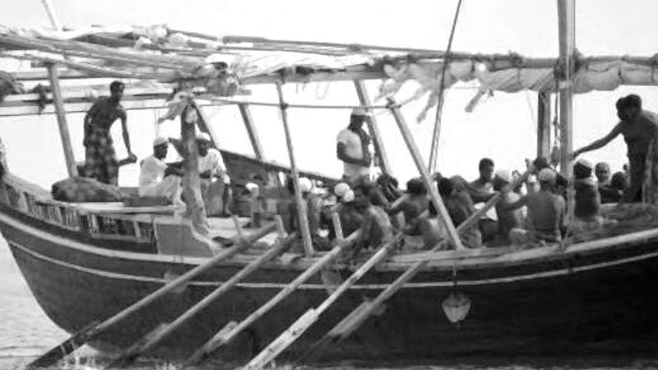
Economy
Notes:
Once dependent on pearl diving, agriculture, fishery, and international trade, the Gulf Arab nations have swiftly transformed into some of the world’s wealthiest countries during the oil era.

Slide 11

Economy
Doha, Qatar
Riyadh, Saudi Arabia
Liwa, Oman
Riyadh 2021
Dubai, UAE
Muscat, Oman

Slide 12
Outline
Oil, gas and Gulf economies
Climate conundrum
Post-oil strategies
Alternative energy
GCC – Singapore energy relations

Slide 13
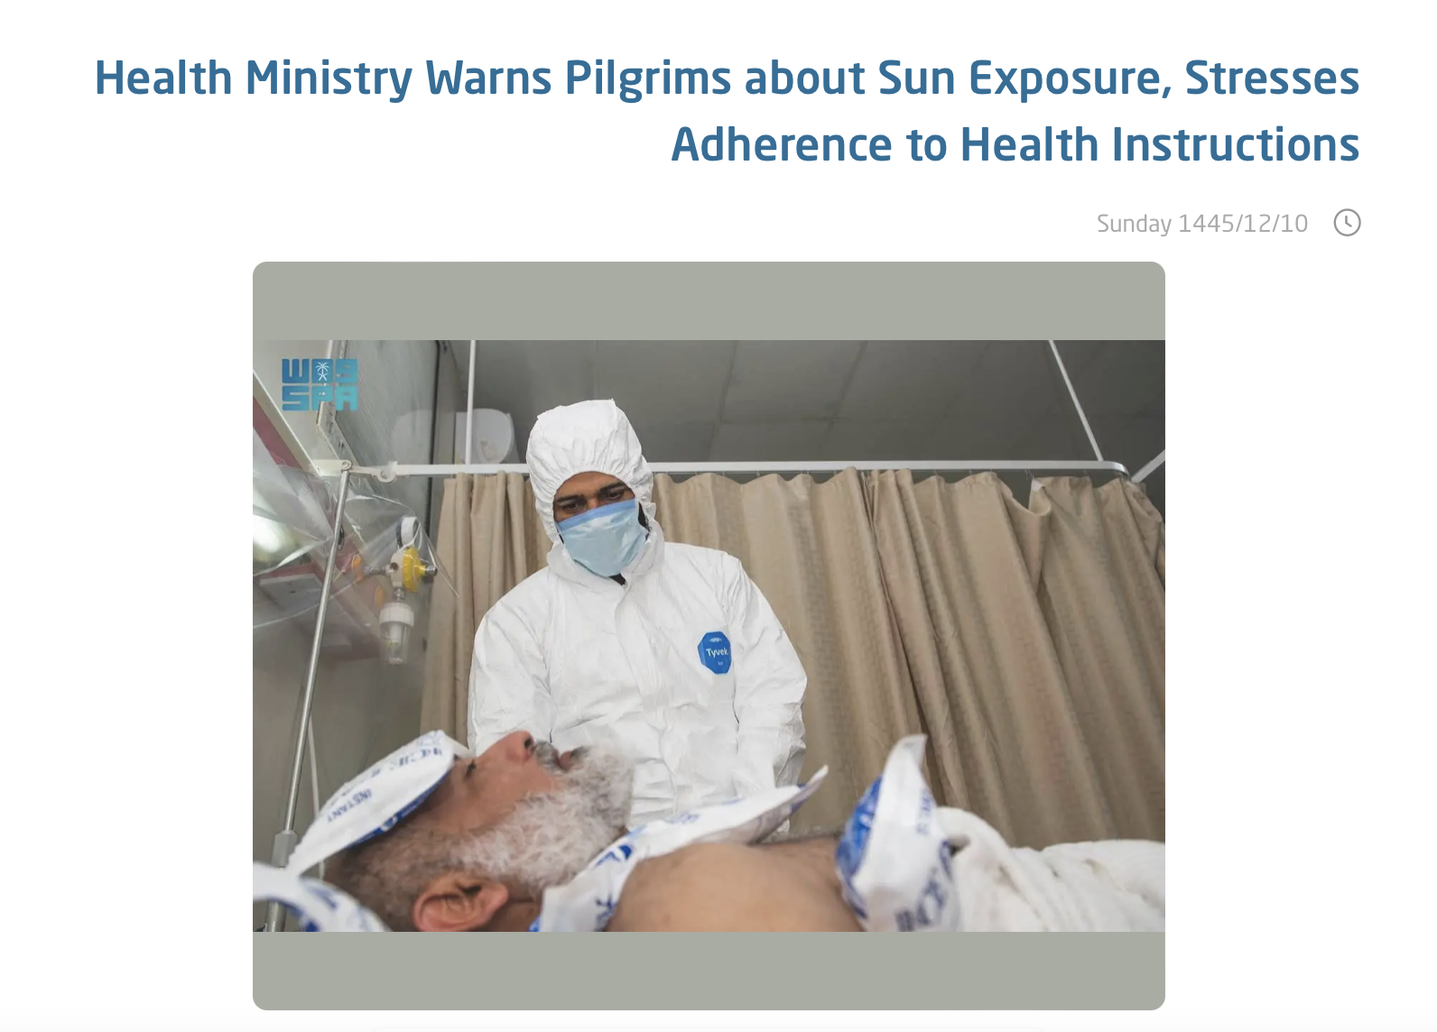
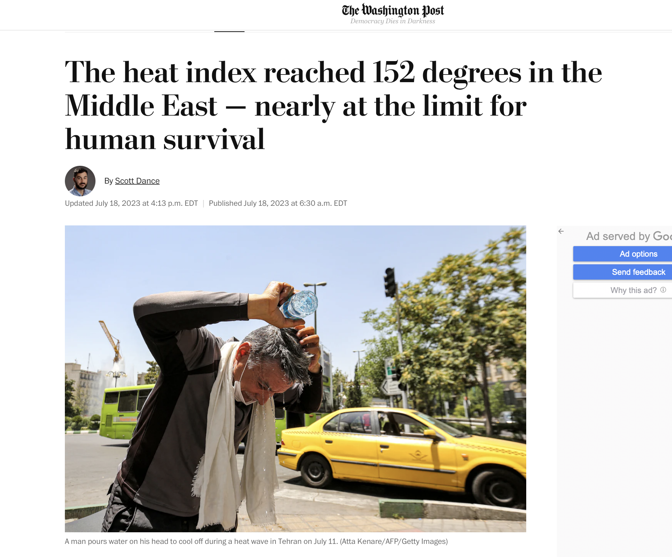
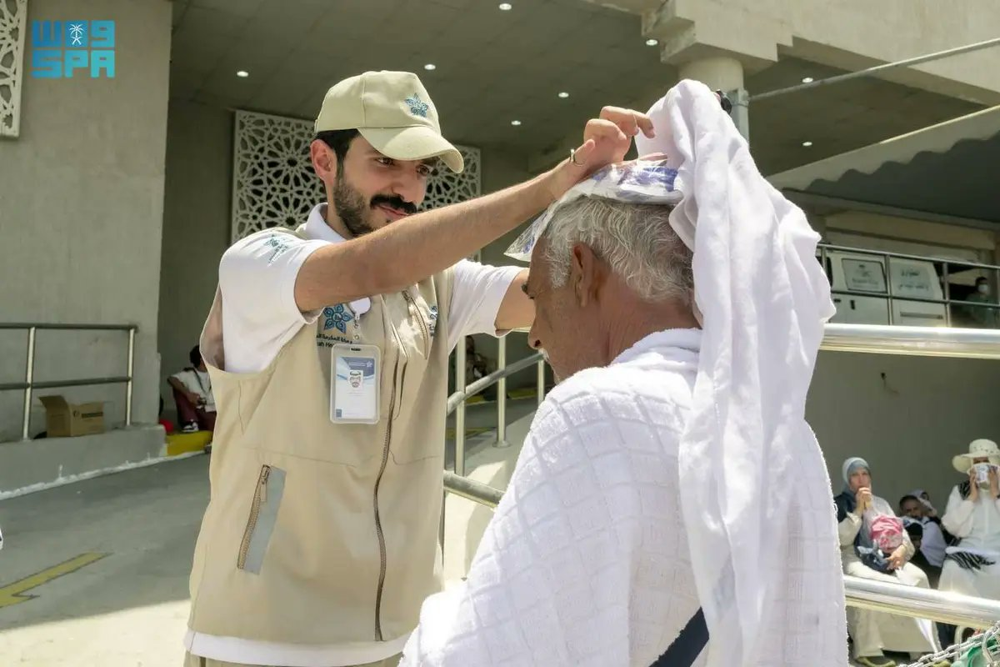
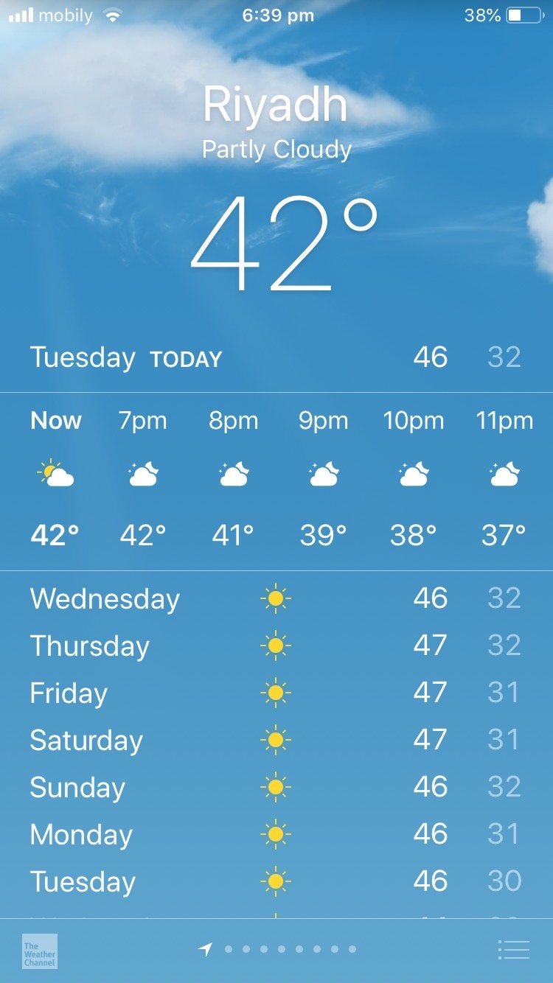

Rising temperatures

Slide 14
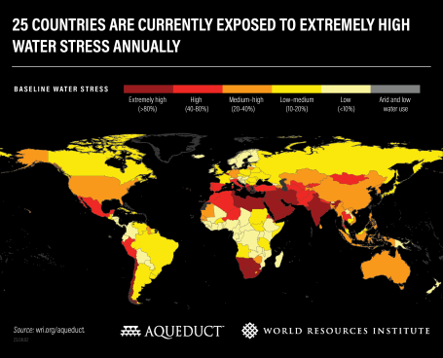
Water scarcity
18 out of 22 Arab countries falling below the water poverty line of 1,000 m3 per capita per year
13 out of 22 Arab states are below absolute water scarcity threshold of 500 m3 per capita per year
(WRI, 2023): The 25 most water stressed countries: Bahrain, Cyprus, Kuwait, Lebanon, Oman, Qatar, UAE, Saudi Arabia, Israel, Egypt, Libya, Yemen, Botswana, Iran, Jordan, Chile, San Marino, Belgium, Greece, Tunisia, Namibia, South Africa, Iraq, India, Syria

Slide 15
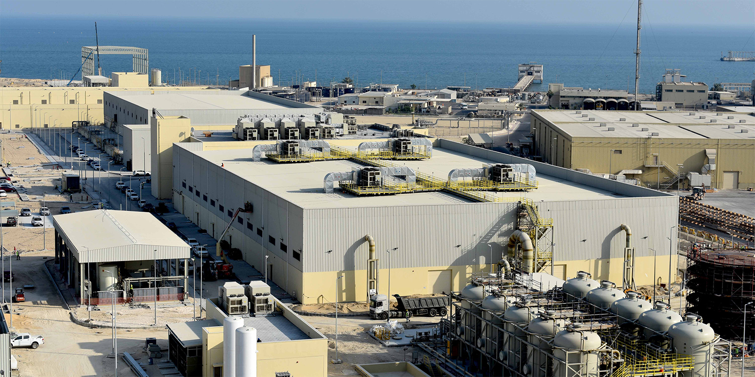
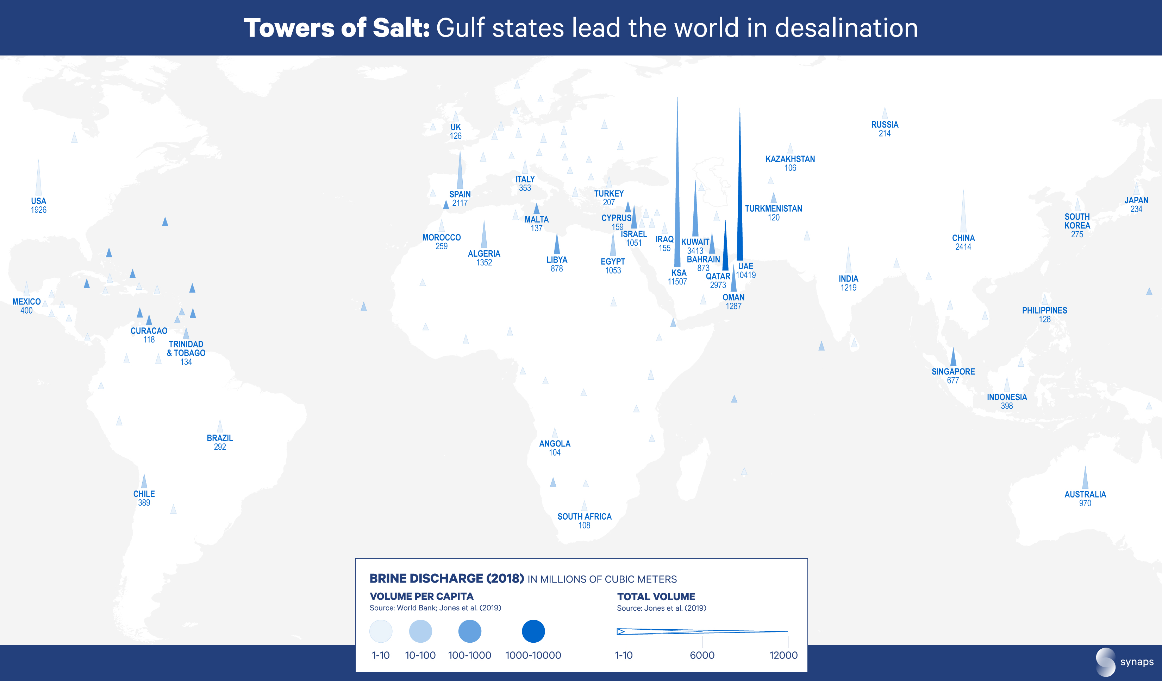
Water scarcity
Al Khobar I desalination plant, Saudi Arabia
Notes:
https://www.acciona.com/updates/news/acciona-completes-construction-al-khobar-desalination-plant-saudi-arabia/
https://throughtheclimatefog.substack.com/p/middle-east-desalination-water-brine

Slide 16
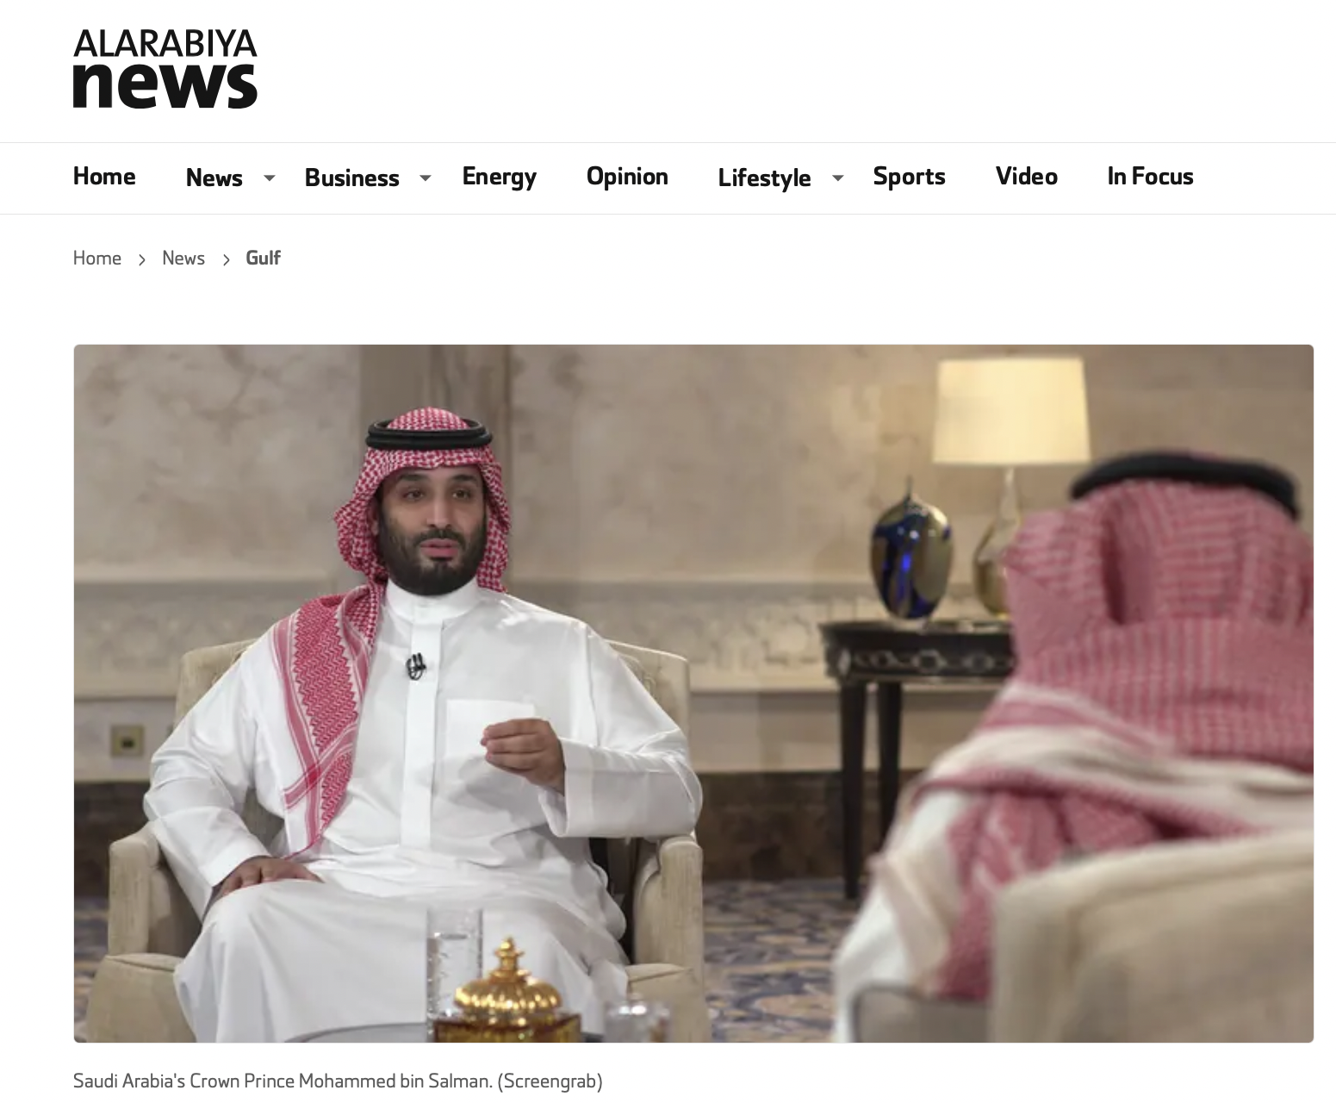
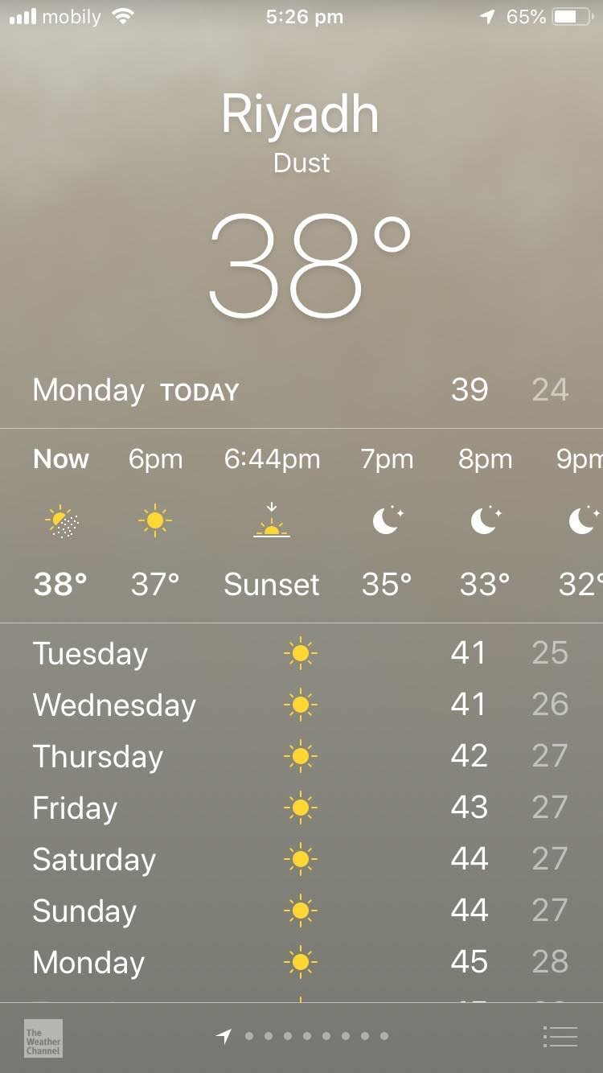
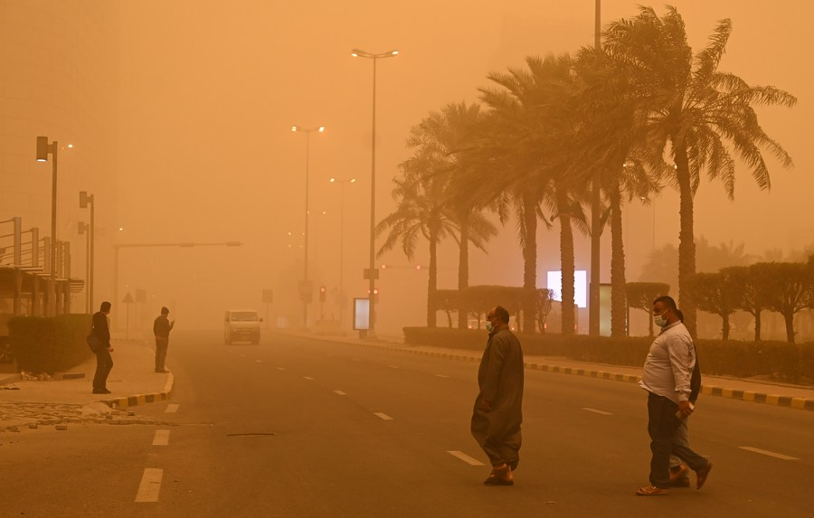
Extreme weather events
Kuwait, sandstorm, 2022
“..my generation and the older one knows is that when we were very young the number of sandstorms were 70 to 80 percent less than what we are suffering from today.” - Saudi Crown Prince Mohammed bin Salman, 2021
June 2020

Slide 17
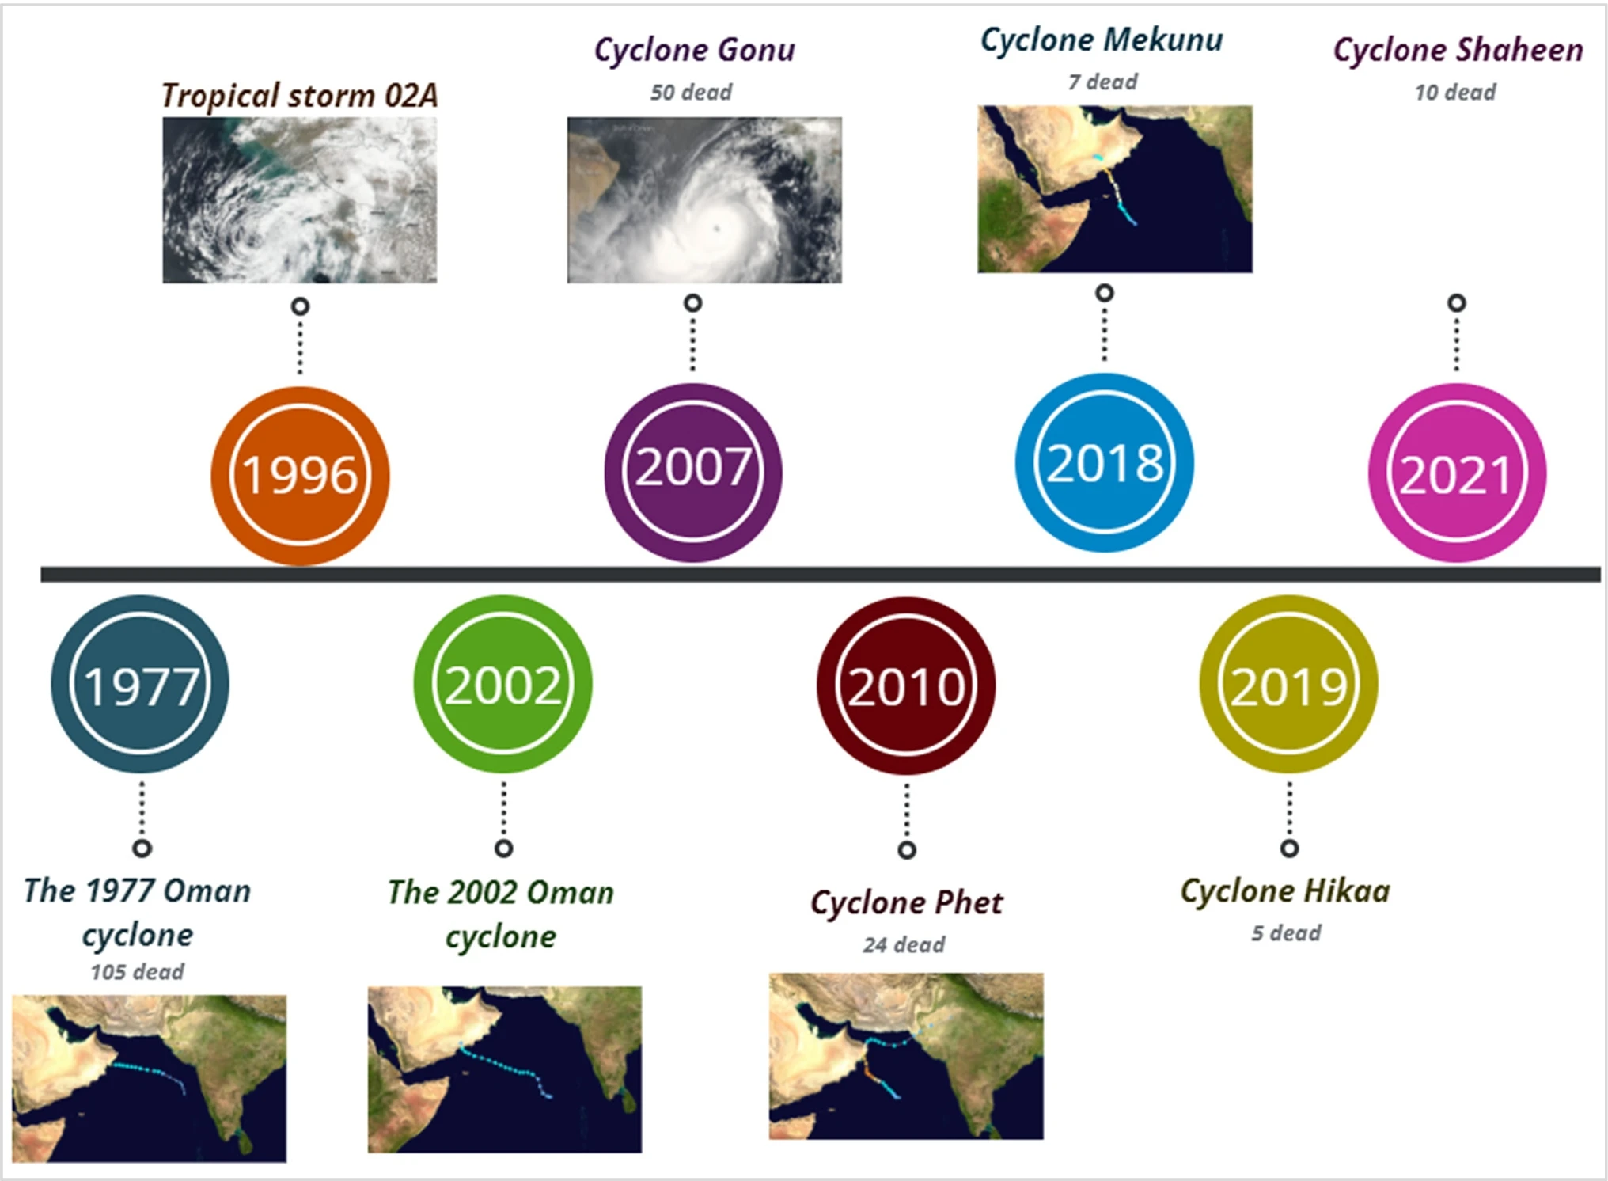
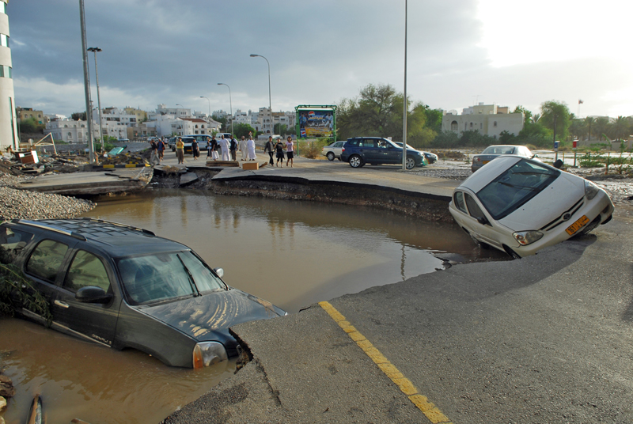
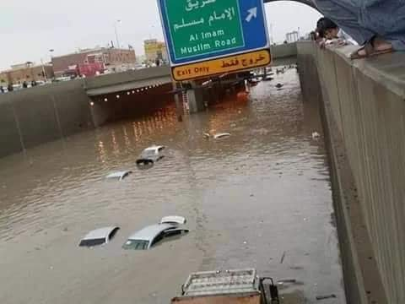
Extreme weather events
Muscat, cyclone Guno, 2007
Riyadh, flash flood, 2019
Notes:
https://link-springer-com.libproxy1.nus.edu.sg/article/10.1007/s12517-022-10118-1#Fig1

Slide 18
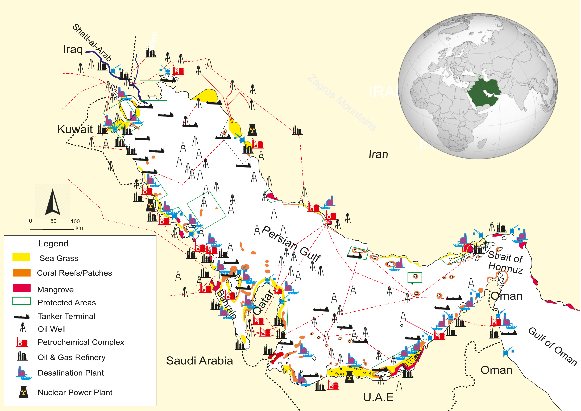
Sea-level rise
90% of Arab Gulf population live in urban areas, most of which are located along the coastline.
Great concentration of infrastructure is along the coastline, including: oil and gas export facilities, power, desalination plants, ports and roads

Slide 19
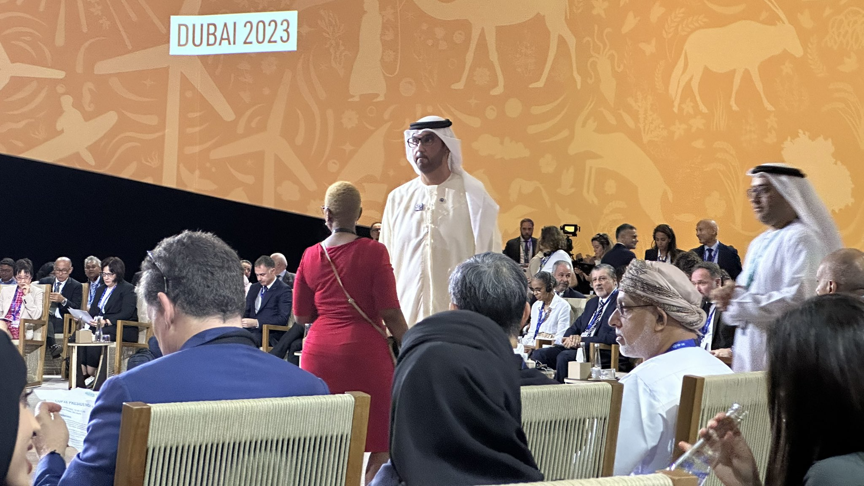
Climate conundrum
Oil and gas not only an important economic pillar, but important resources for Gulf countries to weather climate challenges :
  Cooling
    Air conditioning: makes up 70% of GCC peak electricity consumption
  Water desalination
    The world’s top seawater desalination producers
  Food imports
    Gulf countries import about 85% of their food
COP 28
COP 28 Decision “Transitioning away from fossil fuels in energy systems, in a just, orderly and equitable manner, accelerating action in this critical decade, so as to achieve net zero by 2050 in keeping with the science”

Slide 20
Outline
Oil, gas and Gulf economies
Climate conundrum
Post-oil strategies
Alternative energy
GCC – Singapore energy relations

Slide 21
Post-oil strategies
1. Monetize oil and gas reserves
2. Develop non-oil economic sectors (economic diversification)
3. Develop alternative energy sources

Slide 22
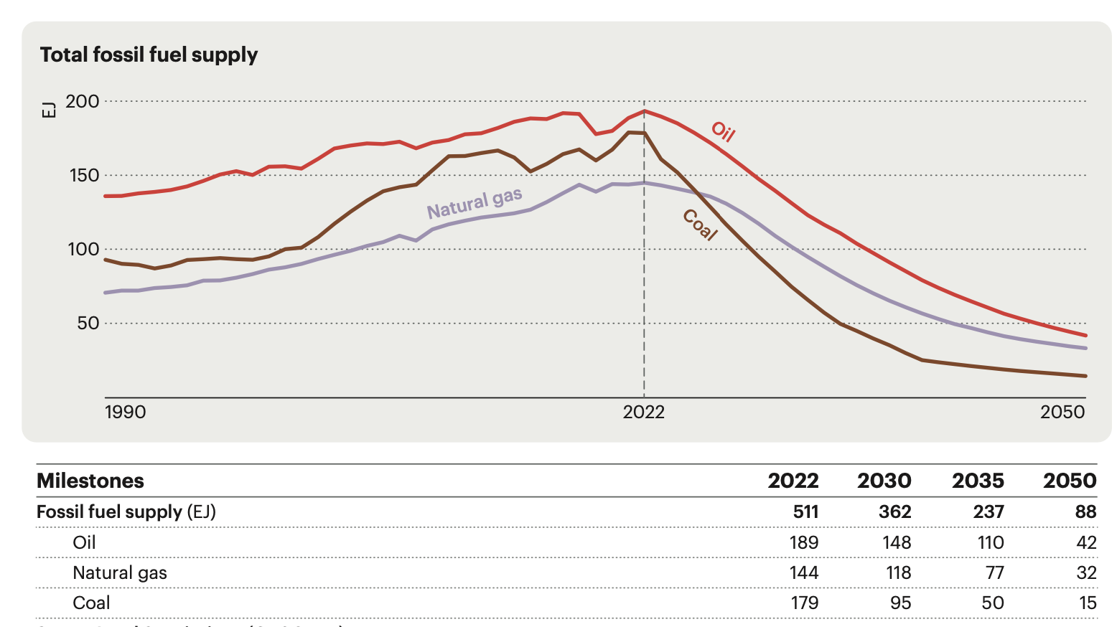
1. Monetise oil and gas resources
Last men standing
Low carbon, low-cost producers
  UAE: Rapidly boost oil production (to boost oil production capacity to five million barrels per day, from the current four million, by 2027, instead of 2030).
  Saudi Arabia: Seek long-term sustainability of oil (to increase of maximum sustainable capacity from 12 million barrels per day (mb/d) in 2022 to 13 mb/d by 2027)
  Qatar: Positioning natural gas as a transitional fuel (to boost LNG output from North Field West from the current 77 million tonnes per year (mtpa) to 142 mtpa by 2030
Securing long-term markets with key energy-consuming nations in Asia:
  Aramco’s stakes in refineries in China , South Korea, Japan, and Malaysia.
  Kuwait Petroleum Co. purchased a 35% ownership and operational stake in a refinery in Vietnam configured around Kuwaiti crude.
  Adnoc 3% equity stake in Azerbaijan’s Absheronn Gas Field. Mubadala Petroleum is the second-largest producer of crude oil in Thailand.

Slide 23


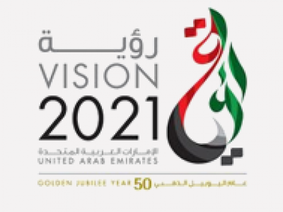



2. Economic diversification: Develop non-oil economic sectors
Country | Vision | Targeted sectors | Global Economic Diversification Index (out of 112) countries
Bahrain | Economic Vision 2030 | Financial sector, Business services, Tourism, Manufacturing, Logistics | 78
Kuwait | Kuwait Vision 2030 | Gas sector, Infrastructure, Trade and Finance | 104
Oman | Oman Vision 2040 | Tourism, Logistics, Manufacturing, Fisheries, Mining | 102
Qatar | Qatar National Vision 2030 | Gas, Education | 97
Saudi Arabia | Vision 2030 | Private sector, Education, Business, Tourism | 91
UAE | We the UAE 2031 | Tourism, Finance, Trade and Commerce, Aviation | 70

Slide 24
Outline
Oil, gas and Gulf economies
Climate conundrum
Post-oil strategies
Alternative energy
GCC – Singapore energy relations

Slide 25
3. Develop alternative energy sources
Country | Net-zero target | Renewable Energy targets | Emissions reduction target | National Climate Strategy | Other climate initiatives/governance entities
Bahrain | Yes, by 2060 | 5% by 2025 10% by 2035 | Cut emissions by 30% by 2035 and reach net zero by 2060 | National Energy Strategy to achieve net zero emissions by 2060 | Joint National Committee on Climate Change (2007)
Kuwait | Yes, by 2060 | 15% by 2030 | Avoid 7.4% of GHG emissions by 2035 relative to a business-as-usual levels | Kuwait National Adaptation Plan 2019-2030; Kuwait 2060 Low-Carbon Strategy | Kuwait National Committee on Climate Change
Oman | Yes, by 2050 | 10% by 2025 30% by 2030 | Reduce greenhouse gas (GHG) emissions by 21% relative to a business-as-usual (BAU) scenario by 2030 | National Strategy for Adaptation and Mitigation to Climate Change, 2020-2040); National Carbon Neutral Strategy | Regulations for the management of climate affairs (2016) National Climate Strategy Oman Sustainability Centre
Qatar | No | 20% by 2030 | Reduce 25% of GHG emissions by the year 2030 | Qatar's National Environment and Climate Change Strategy (QNE) | National Climate Change Committee (chaired by the Ministry of Environment)
Saudi Arabia | Yes, by 2060 | 50% by 2030 | Reduce, avoid and remove GHG emissions by 278 million tons of carbon dioxide equivalent (MtCO2e) annually by 2030 | National Circular Carbon Economy Program; Saudi Green Initiative; Middle East Green Initiative | National Committee for the Clean Development Mechanism/Designated National Authority(2009) Saudi Green Building Forum (2010) Saudi Energy Efficiency Center (2012) PIF Regional Voluntary Carbon Market Company
UAE | Yes, by 2050 | Clean energy 50% (44% RE, 6% Nuclear) by 2050 | 31% reduction compared to the business-as-usual scenario for the year 2030 | 2017: Green Growth Strategy/UAE Green Agenda 2015-2030 | Dubai Integrated Energy Strategy 2030 Abu Dhabi Carbon trading exchange and carbon clearing

Slide 26
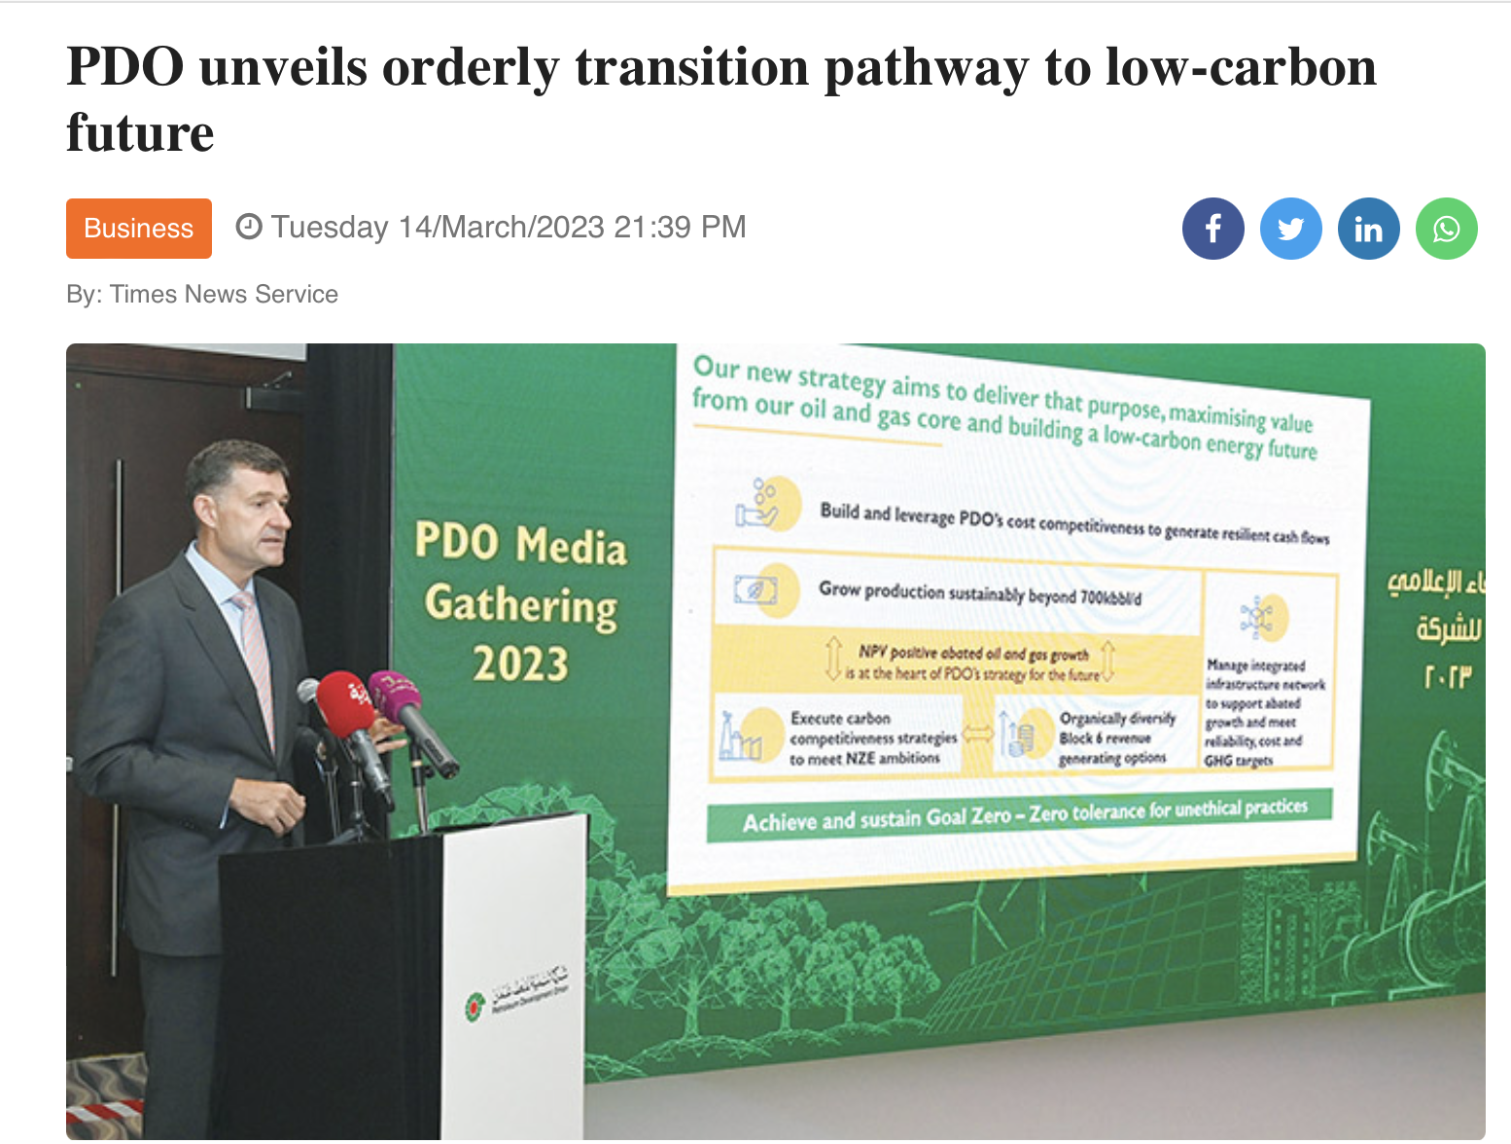
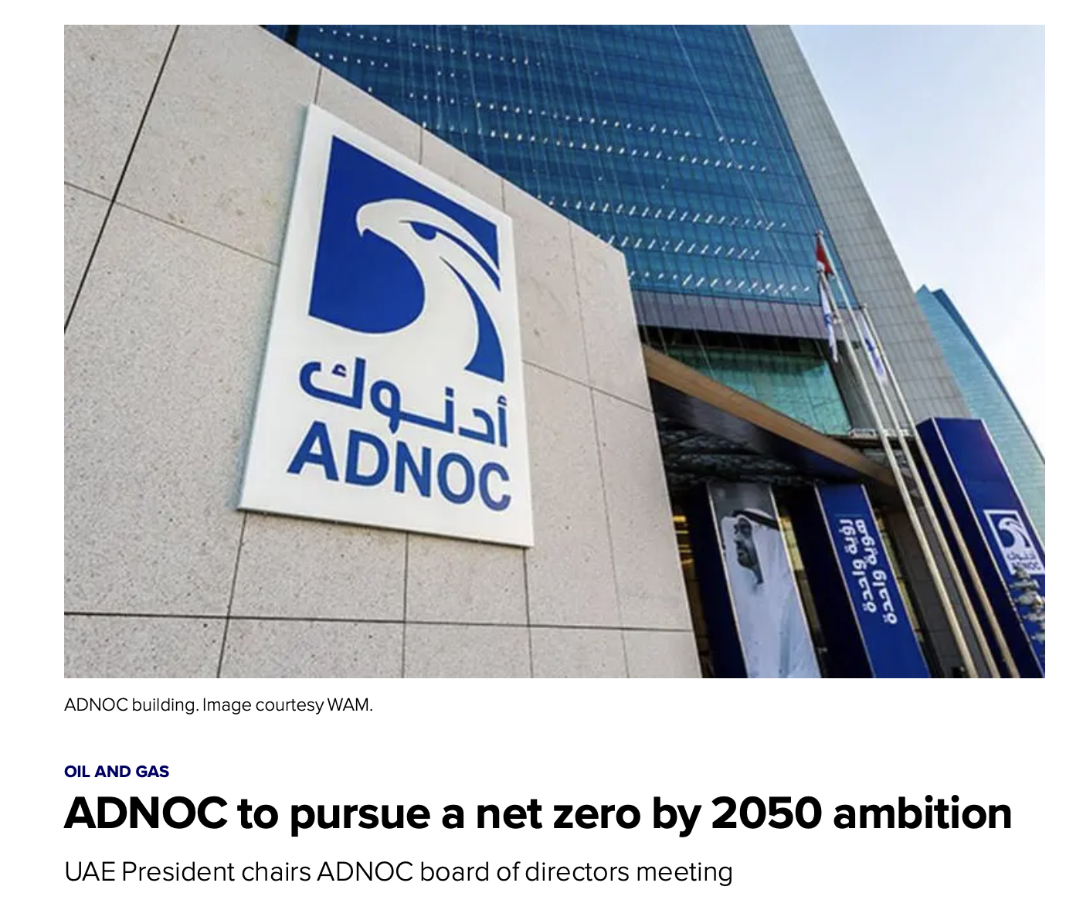
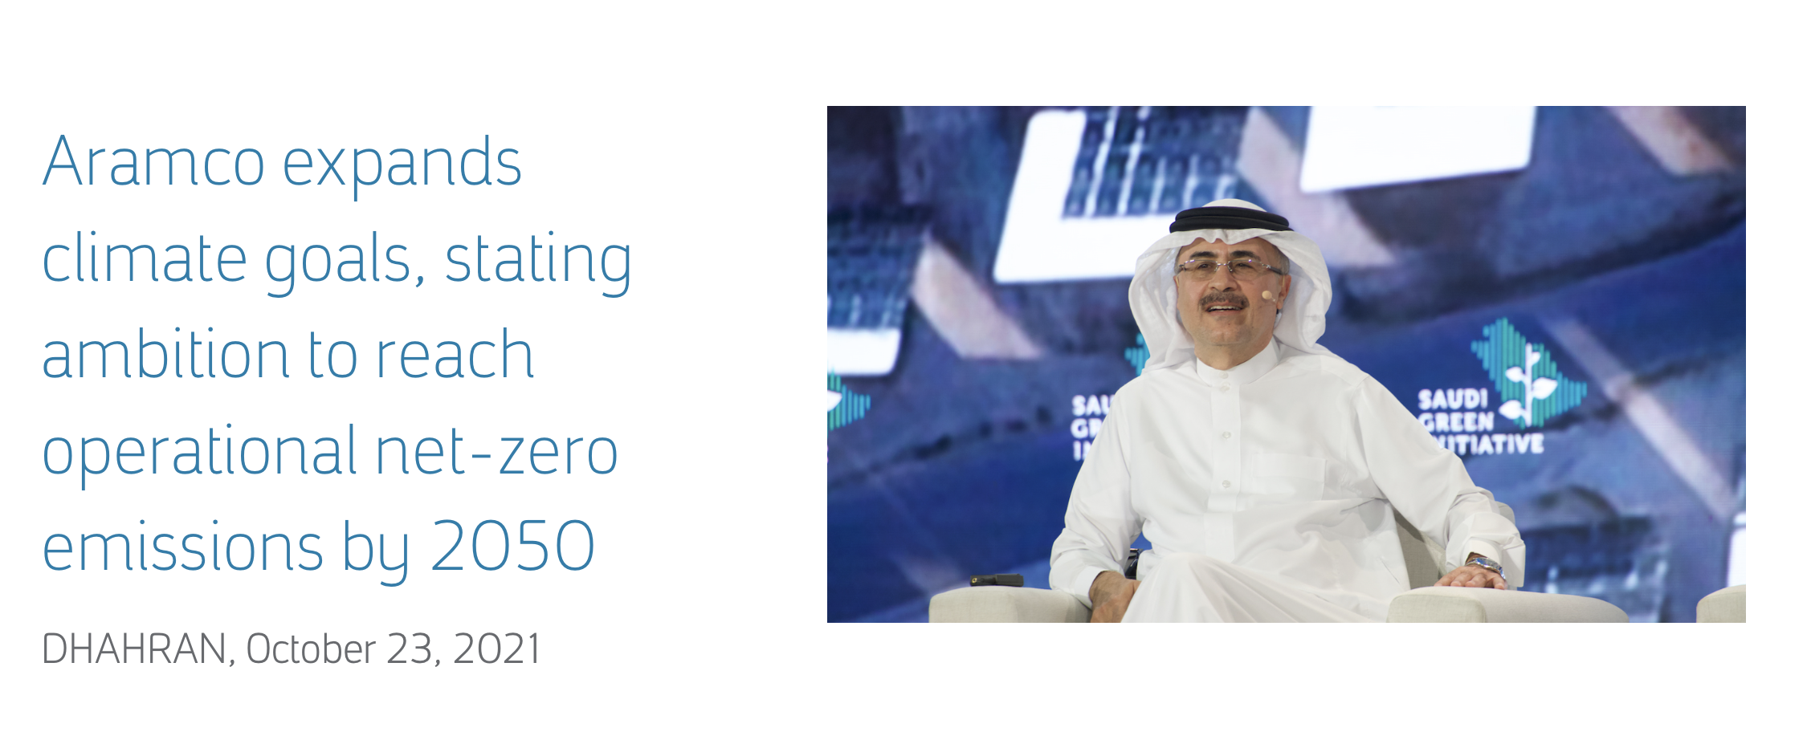
National oil companies also setting net-zero targets
2024

Slide 27
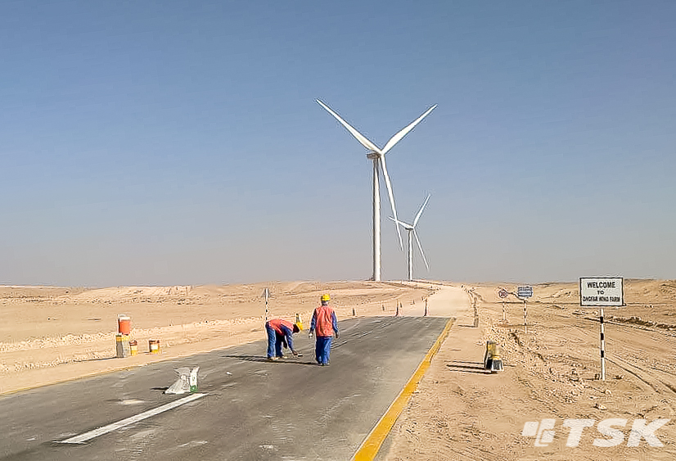
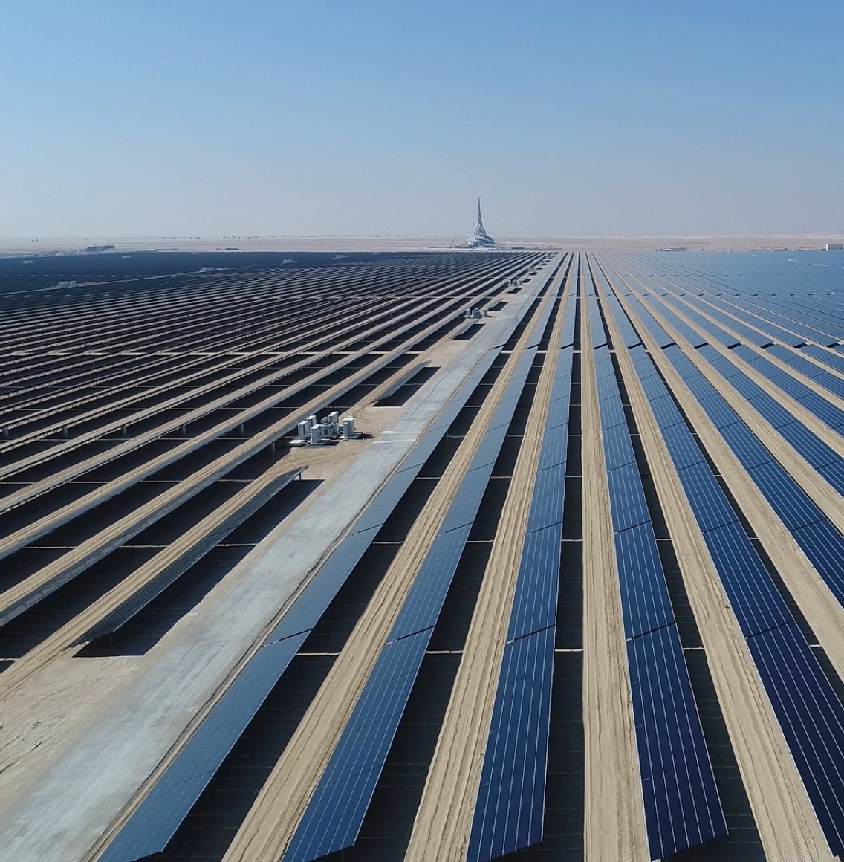
Renewable Energy
Dhofar 50 MW Wind Farm, Oman
Renewable energy installed capacity in the Gulf countries , 2012-2021
Mohammed bin Rashid Al Maktoum Solar Park, Dubai
27

Slide 28
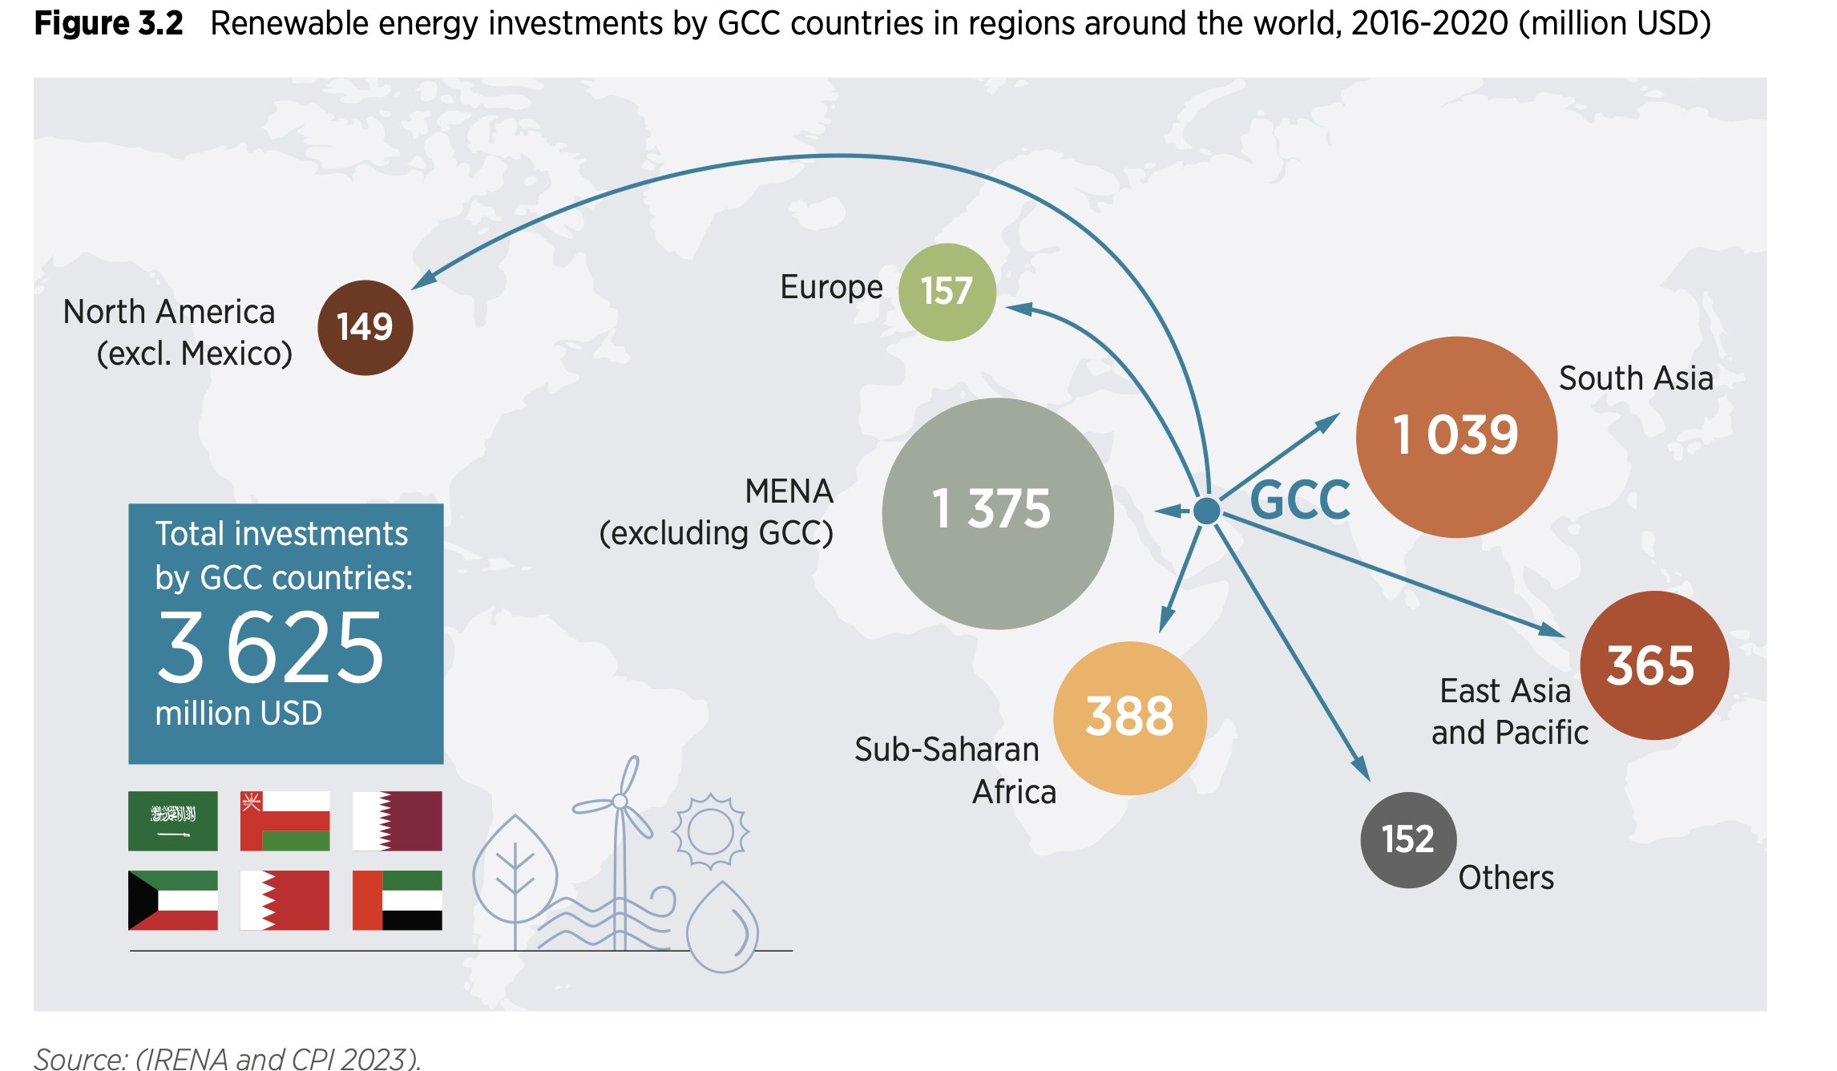
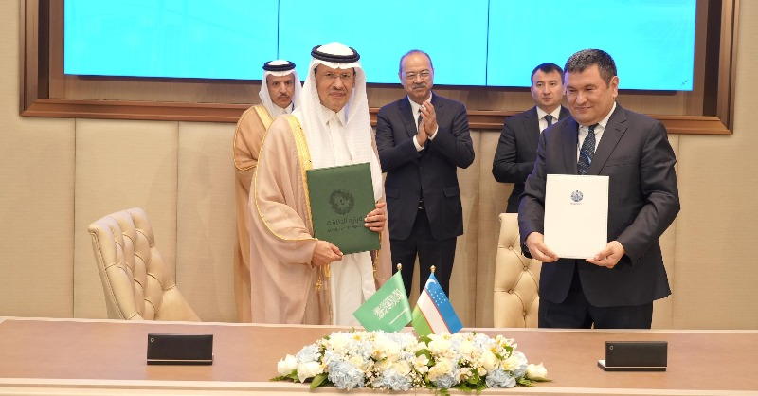
Renewable Energy
Gulf renewable energy investments regionally and globally, 2016-2020.
Saudi Arabia and Uzbekistan sign "road map" for energy cooperation
28
Notes:
https://www.moenergy.gov.sa/en/MediaCenter/News/Pages/Saudi-Arabia-and-Uzbekistans-Joint-Energy-Cooperation-Statement-Strengthening-ties.aspx

Slide 29
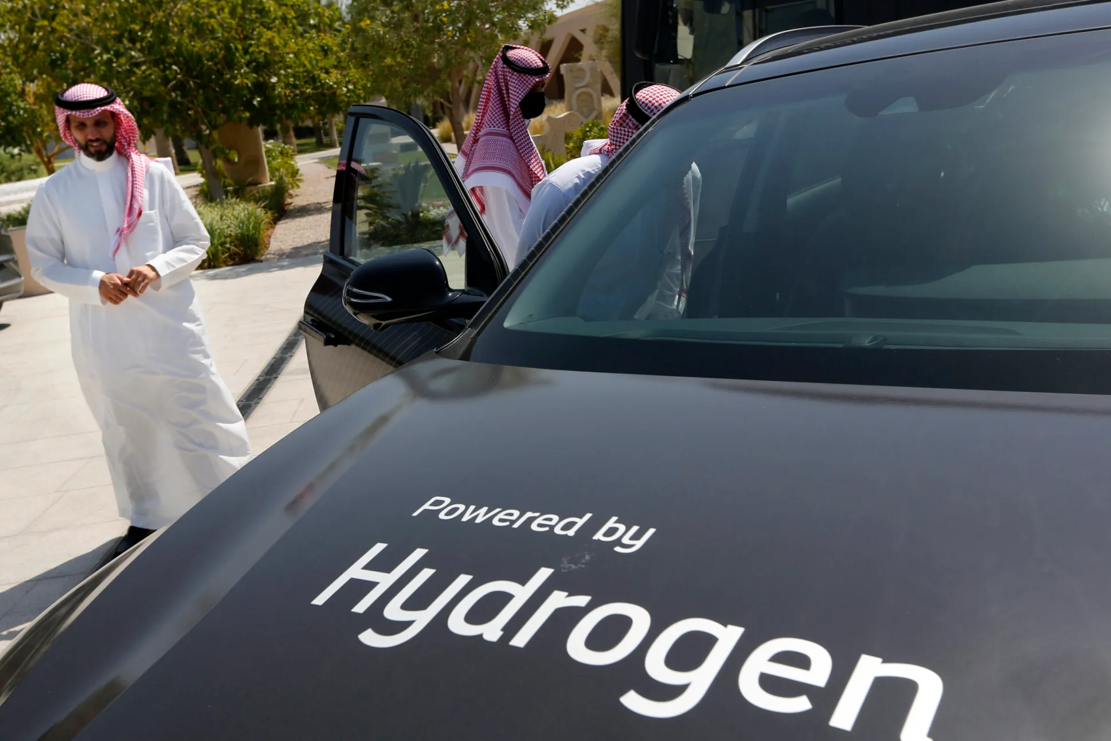
Hydrogen
Current and Planned Gulf Hydrogen Projects
Project name | Country | Date online | Status | Type of electricity (for electrolysis projects) | Product | Announced Size
Green hydrogen plant | BHR |  | Concept |  | H2 | 4MW
Oman green H2 project, phase 1 | OMN | 2028 | Concept | Others/Various | H2 | 4.7GW
Oman green H2 project, phase 2 | OMN | 2038 | Concept | Others/Various | H2 | 14GW
Hyport@Duqm | OMN | 2026 | Feasibility study | Others/Various | Various | 250-500MW
Sumitomo Oman | OMN | 2023 | Feasibility study |  | H2 | 0.3-0.4 kt H2/y
PDO’s solar-paneled car park | OMN |  | Feasibility study | Solar PV | H2
Amin Solar Renewable Energy Project | OMN |  | Feasibility study | Solar PV | H2
Port of Duqm NH3 plant | OMN | 2023 | Feasibility study | Unknown | Ammonia | 2400 t NH3/d
SalalaH2 project | OMN | 2023 | Unknown | Wind and solar | Green Ammonia | 400 MW 1,000 t NH3/d
Helios Green Fuels - Neom | SAU | 2025 | FID | Others/Various | Various | 650t H2/d - 1.2Mt NH3/y
Dewa green hydrogen pilot project | UAE | 2021 | Implemented | Solar | H2 | 300-kilowatt
Mubadala/Snam green hydrogen projects | UAE |  | Feasibility study | Solar | H2 | Unknown
DoE/Masdar plus five firms pilot project | UAE | 2022 | Feasibility study | Solar | H2 | 1,000 mt/year 20 MW
ADNOC low-carbon ammonia plant | UAE | 2025 | Under construction | Natural gas | Blue Ammonia | 1 mt NH3/yr
Source: Al-Sarihi, A. 2022. Gulf States Hedge Against Global Energy Transition, Now With Hydrogen. Arab Gulf States Institute in Washington

Slide 30
Hydrogen
Oman
National Hydrogen Strategy
National alliance for hydrogen consisting of 13 local authorities
National hydrogen company, Hydrogen Development Oman
UAE
Abu Dhabi Hydrogen Alliance (Mubadala Investment Company, ADNOC, and Abu Dhabi holding company ADQ)
Hydrogen Leadership Roadmap (to capture 25% of the global low-carbon hydrogen market by 2030.)
Saudi Arabia:
The Ministry of Energy signed a memorandum of understanding with a number of local authorities to demonstrate the viability of hydrogen use in transportation and industry
Saudi Arabia announced a $5 billion green hydrogen plant, to be powered by renewables and built in the futuristic city of Neom
Source: Al-Sarihi, A. 2022. Gulf States Hedge Against Global Energy Transition, Now With Hydrogen. Arab Gulf States Institute in Washington

Slide 31
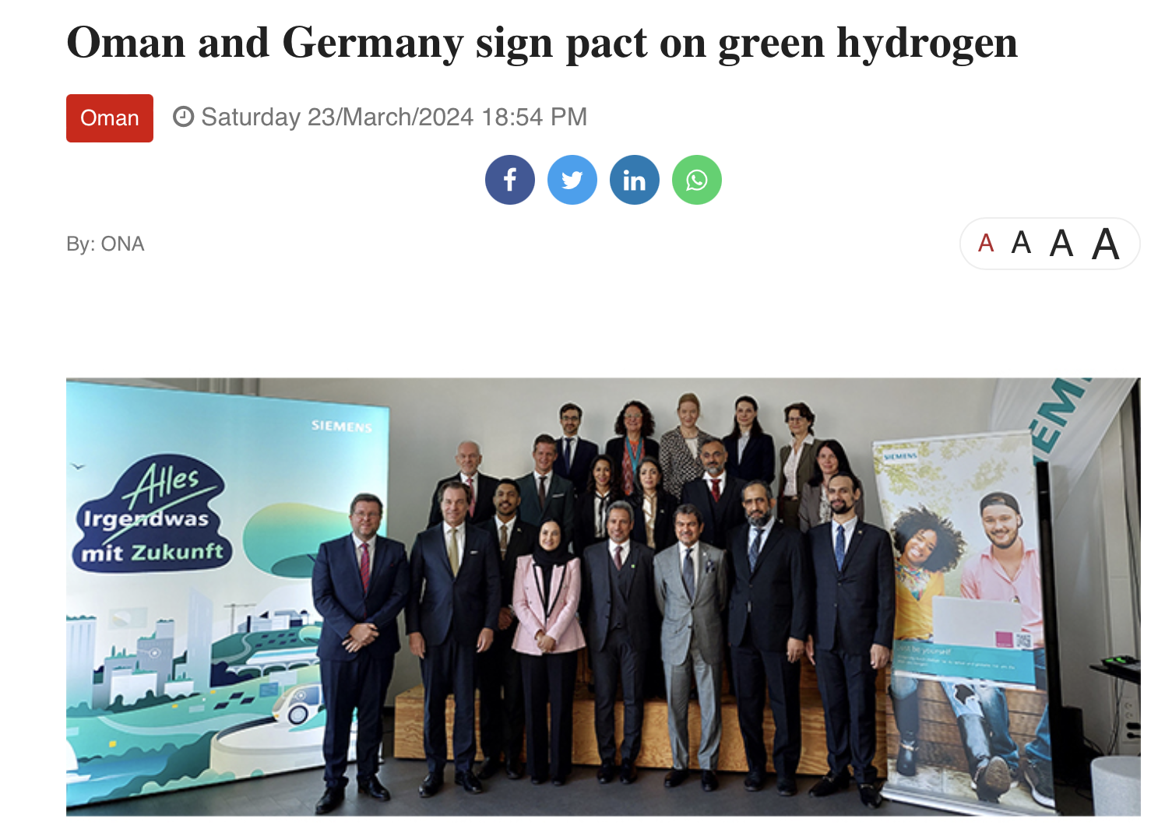
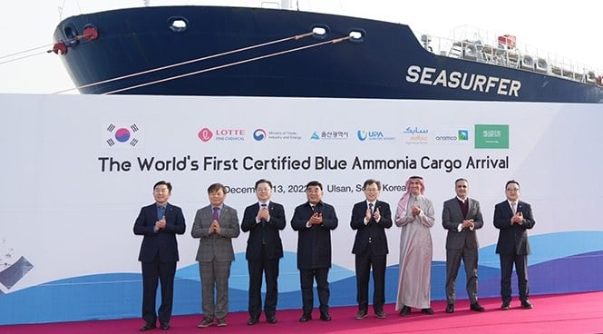
Hydrogen partnerships
China
Gulf international hydrogen alliances, i.e., countries with whom MoU, partnerships, agreements, are signed. Source: Author compilation

Slide 32
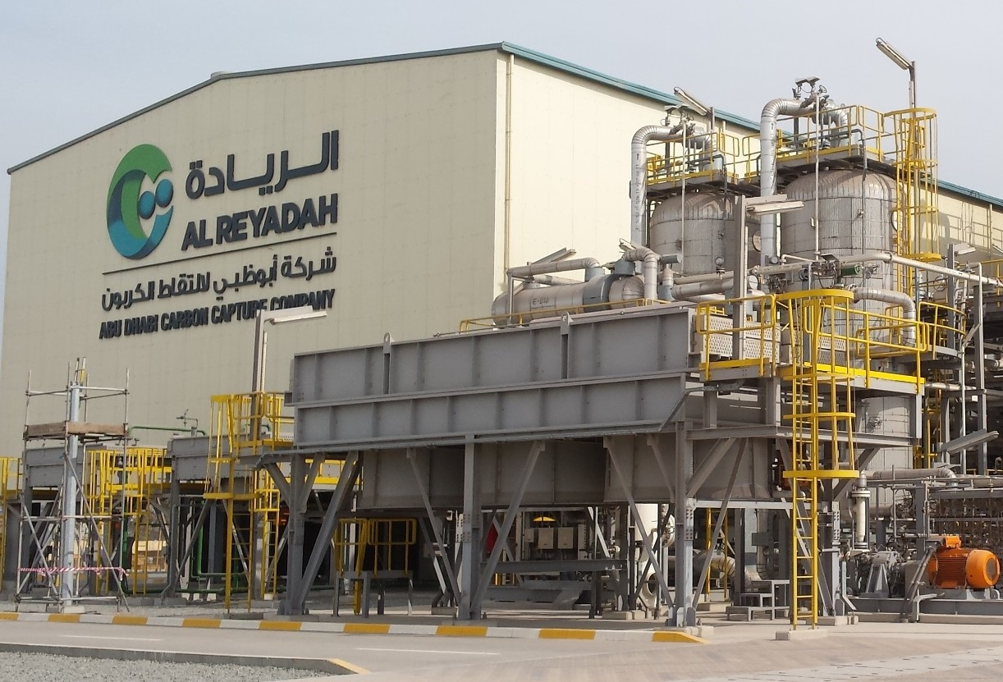
Carbon capture and storage (CCS)
Three major CCS facilities in the Gulf:
Saudi Arabia:
  Saudi Aramco’s Uthmaniyah CO₂-EOR Demonstration Project
  The Saudi Basic Industries Corporation’s Jubail CO₂ to chemicals plant
UAE
  The al-Reyadah project.

Slide 33





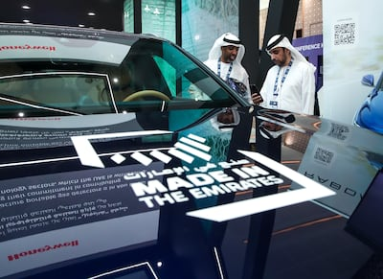
Electric Vehicles (EVs)
Manufacturing ambitions
Oman
Qatar
Saudi Arabia
UAE
To have 22,000 EVs by 2030 and to install 350 public chargers by 2026
35% of its fleet and 100% of its public transportation buses to become electric by 2030
5% of parking spaces be reserved for EVs and charging stations be installed in all car parks.
To install over 5,000 fast chargers across more than 1,000 locations by 2030
Electric and hybrid vehicles to constitute 50% of the total vehicle fleet by 2050.
To to increase charging stations from 914 to 10,000 by 2030

Slide 34
Outline
Oil, gas and Gulf economies
Climate conundrum
Post-oil strategies
Alternative energy
GCC – Singapore energy relations

Slide 35
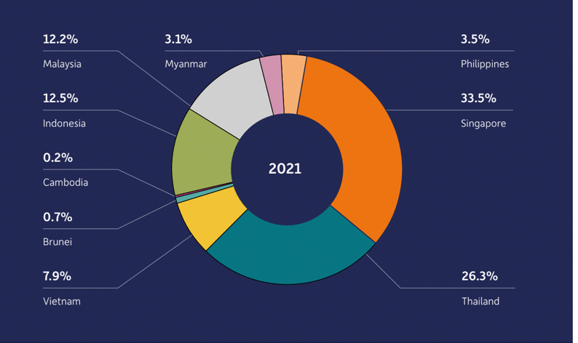
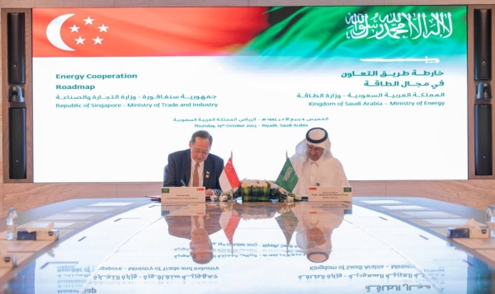
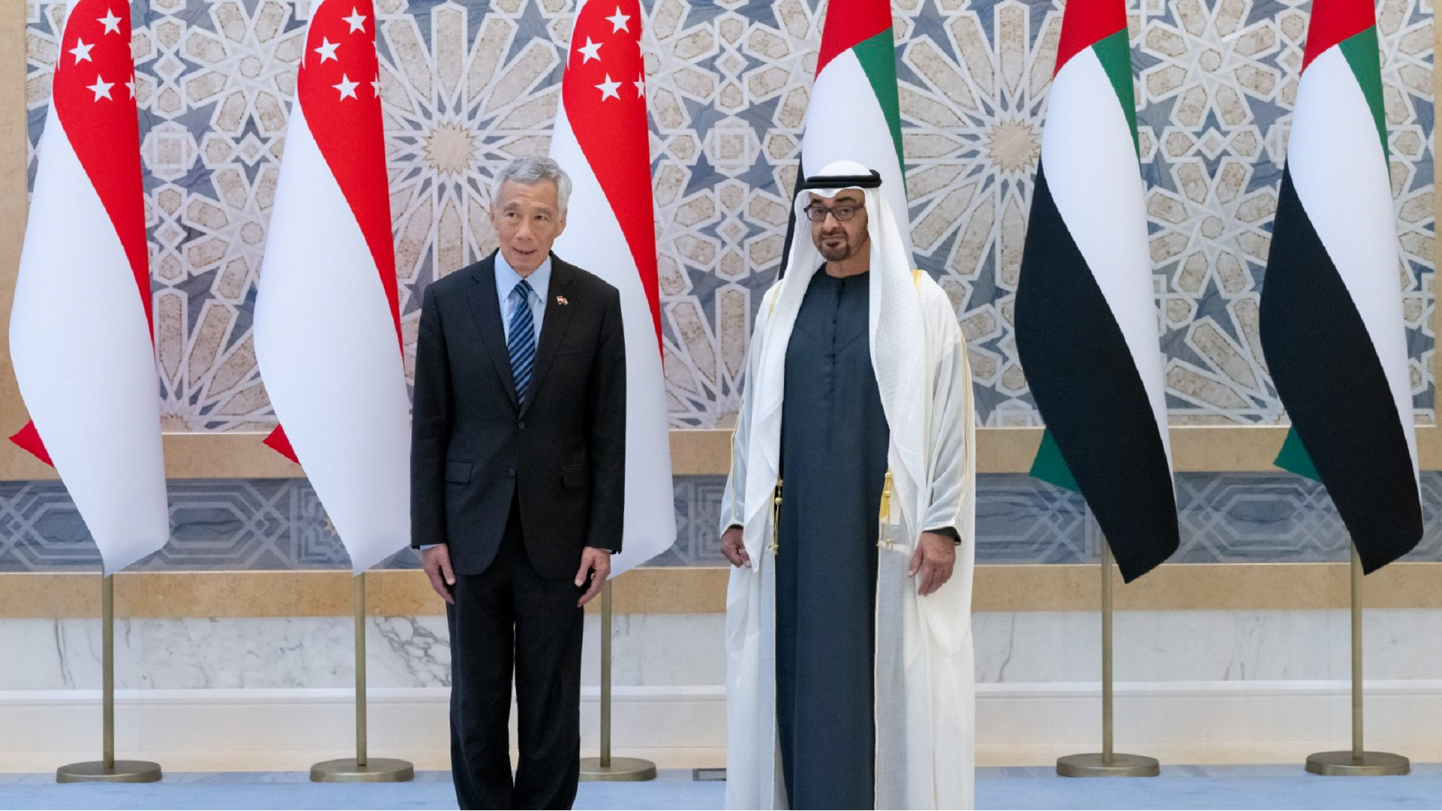
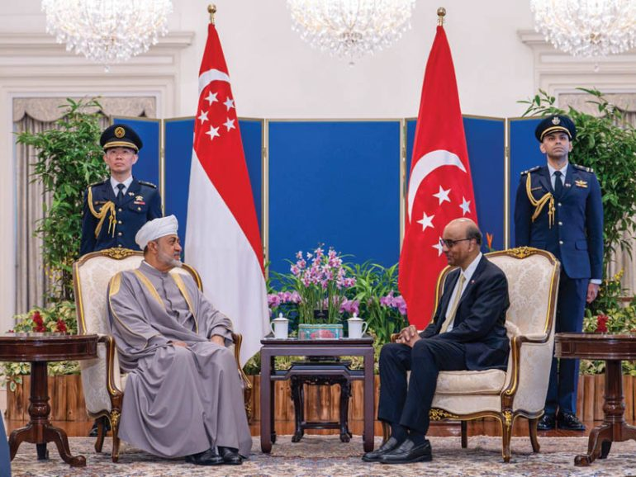
Gulf-Singapore energy relations
FTA: Singapore is Gulf major trade partner, the only ASEAN country to have an FTA with the GCC.
UAE– Singapore Comprehensive Partnership (SUCP)
  Abu Dhabi Singapore Joint Forum (ADSJF)
  Singapore – UAE Joint Committee (SUJC)
Saudi - Singapore Joint Committee (SSJC)
Singapore-Oman Strategic Dialogue
Energy relations
  Over two-thirds of Singapore’s crude oil imports come from the United Arab Emirates, Qatar, Saudi Arabia, and Kuwait.
  Singapore receives liquefied natural gas (LNG) from Qatar and Oman
Common climate change challenges
  E.g. water security, food security, sea level rise, extreme weather events
Mutual energy transition/green economy aspirations
  Green Hydrogen
  Switch to natural gas
  Scale up renewable energy
  Carbon capture and storage
  Nuclear (SMR)
  EV
  Carbon markets
  Just energy transition
Proportion of total ASEAN trade with GCC (2021). Source: IMF 2022
Saudi Arabia & Singapore sign Energy Cooperation Roadmap, October 2023
Prime Minister Lee Hsien Loong visit to the United Arab Emirates, 21-22 October 2023
His Majesty Sultan Haitham bin Tarik, Sultan of Oman, visit to Singapore, 13-15 December 2023
Notes:
https://www.eia.gov/international/analysis/country/SGP
https://www.mfa.gov.sg/Newsroom/Press-Statements-Transcripts-and-Photos/2023/10/20231022---PMV-UAE-Statement
https://www.mfa.gov.sg/Newsroom/Press-Statements-Transcripts-and-Photos/2023/10/20231021-PMV-to-KSA
https://www.saurenergy.me/saudi-arabia-singapore-envision-roadmap-for-energy-co-operation/
https://www.mfa.gov.sg/Newsroom/Press-Statements-Transcripts-and-Photos/2023/12/SG-Oman-Joint-Statement

Slide 36
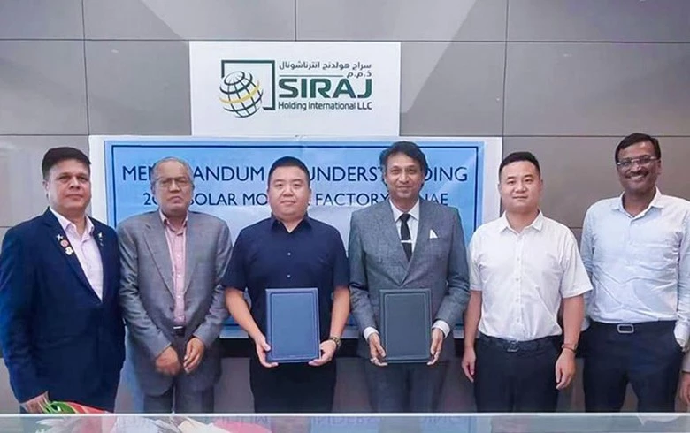
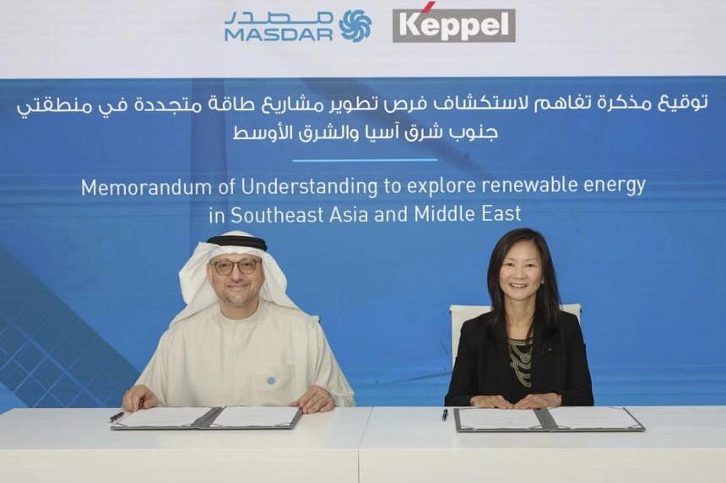
Singapore investments in the Gulf clean energy
Oman
  Sembcorp Utilites
  500 megawatt (MW) solar power plant in Oman through 80 per cent-owned joint venture with Jinko Power Technology to build, own and operate.
  Salalah Independent Water and Power Plant (40% owned by Sembcorp Utilities (Singapore) and 13% owned by Oman Investment Corporation)
UAE
  Gstar
  to build a 2-GW solar module factory in the UAE (Memorandum of Understanding (MoU) with a consortium led by UAE-based diversified investment company Siraj Group)
  Singapore’s Tuas Power
  Singed an MOU with Masdar, France’s EDF Renewables [EDF:FP], and PT Indonesia Power to develop the renewables in Indonesia and export them to Singapore.
  Keppel Corporation
  MOU with Masdar to explore sustainability solutions in Asean and the Middle East
  AirCarbon Exchange (ACX)
  Along with the Abu Dhabi Global Market (ADGM) created a carbon trading exchange and clearning house
Notes:
https://renewablesnow.com/news/singapores-gstar-plans-2-gw-solar-module-factory-in-uae-867429/
https://www.businesstimes.com.sg/companies-markets/sembcorp-wins-first-greenfield-renewables-project-middle-east
https://senecaesg.com/insights/singapore-to-collaborate-with-uae-on-low-carbon-technologies/

Slide 37
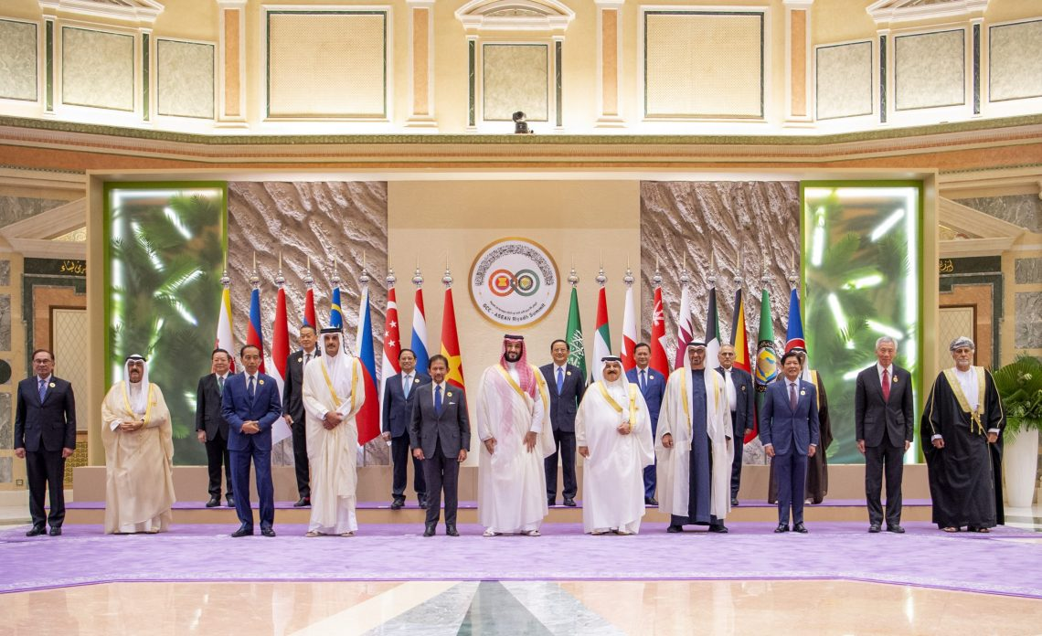





Gulf and Southeast Asia – climate and energy relations
Food security
Water management
Finance
Clean energy
Carbon markets
Food trade and Exchange of good practice for agri-food production
GCC imports between 50-90% of its food needs
Singapore, Indonesia, and Malaysia are major players in the halal food sector.
Knowledge-collaboration
Information sharing from current practices and lessons learned on water management at national and regional levels
Co-investments in clean energy, food security, carbon offset
Renewable energy: UAE’s Masdar signed a power purchase agreement (PPA) for renewable energy projects in Indonesia and Malaysia
Forestry, mangrove preservation: agreement for the rehabilitation of 600,000 hectares of mangrove lands in Indonesia
Knowledge sharing and co-investments in:
Commitments to net-zero goals
Carbon capture and storage technologies
Hydrogen
Carbon trading and offsetting:
ASEAN rich in forests and biodiversity, with great potential as carbon reservoirs
GCC, with arid environment can tap on ASEAN carbon market

Slide 38

Thank you
Q&A

